Slide 1
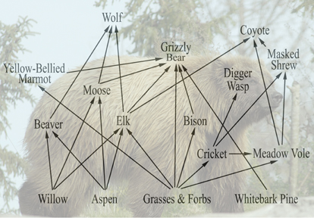
Focus Lesson : HUMAN IMPACT ON Food Webs INTRODUCTION
Complete a table for the food web identifying the Producers, 1st Level Consumers, Higher level Consumers, Herbivores, Omnivores, and Carnivores.
Construct two different food chains from the food web shown.
What is the apex predator?
What do you propose would happen if wolves were killed off by human hunters?
If humans were allowed to over hunt elk, what do you propose would happen to the food web?
If 4500 J of energy was available to the grasses & forbs from the sun, considering the shortest route of consumption, how much energy would make it to the wolf? Show your work.

Slide 2
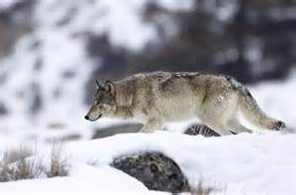
How does the actions of humans affect ecosystems?
SC.912.L.17.20 Predict the impact of individuals on environmental systems, and examine how human lifestyles affect sustainability.
SC.912.L.17.9 Use a food web to identify and distinguish producers, consumers, and decomposers. Explain the pathway of energy transfer through trophic levels and the reduction of available energy at successive trophic levels.

Slide 3
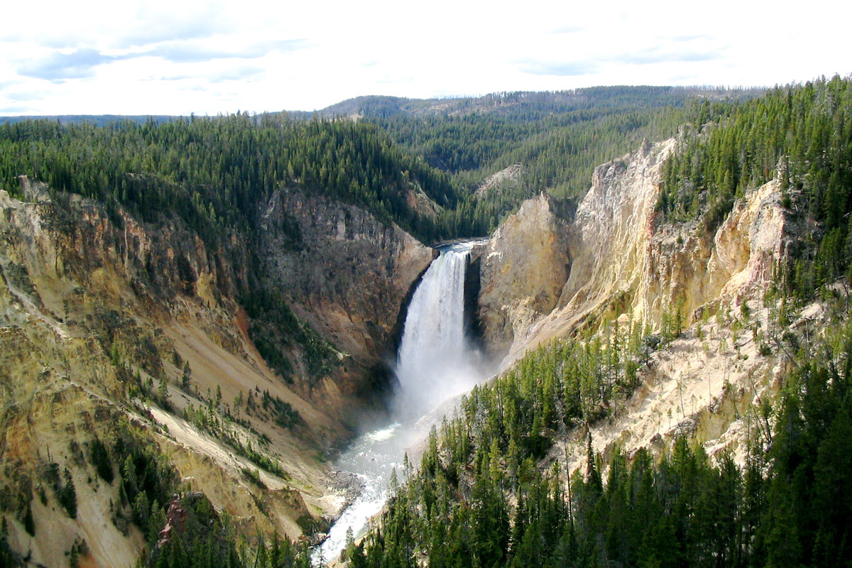
Focus Lesson : HUMAN IMPACT ON Food Webs EXPLICIT INSTRUCTION & Guided Practice
Watch – The Yellowstone Case: The importance of predators
What changes have occurred in the Yellowstone National Park that were disturbing to ecologists?
What other explanations did they rule out as to why the aspens were disappearing? Why did they rule those reasons out?
What was likely responsible for destabilizing the Yellowstone National Park ecosystem? How and when did this happen?
What solution did ecologist propose to rejuvenate the park? Was this solution widely accepted? Why or why not?
What impact did this solution have on the Yellowstone National Park ecosystem? Explain.

Slide 4
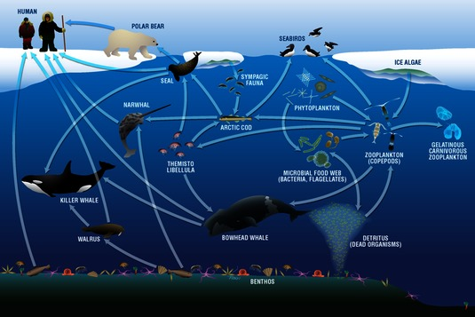
Focus Lesson : HUMAN IMPACT ON Food Webs Independent practice
Complete a table for the food web identifying the Producers, 1st Level Consumers, Higher level Consumers, Herbivores, Omnivores, and Carnivores.
Construct two different food chains from the food web shown.
What is the apex predator?
What do you propose would happen if the bowhead whales were killed off by human hunters?
What impact do you think an oil spill would have on this aquatic ecosystem?

