Slide 1
FOCUS LESSON : POPULATIONS INTRODUCTION
(1) New U.S. census data showed that in 2015, Illinois was the state with the greatest decrease in its population. In order for this decline to occur, which of the following statements must be true?
A. Immigration rates exceeded emigration rates during the year.
B. Emigration rates exceeded immigration rates during the year.
C. The death rate was less than the birth rate for part or all of 2015.
D. The birth rate in large metropolitan areas equaled the homicide rate.
(2) Wildfires are a normal part of ecological succession in nature. However, recent outbreaks of wildfires in California resulted in over 6000 areas being destroyed. What type of population factor is demonstrated by this example?
A. density-independent with local loss of biodiversity
B. density-dependent with local loss of biodiversity
C. density-independent with no biodiversity changes
D. density-dependent with no biodiversity changes

Slide 2
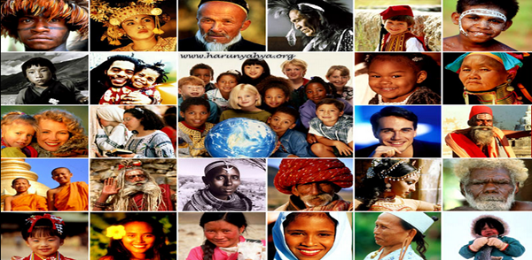
What factors influence the carrying capacity of populations?
SC.912.L.17.5: Analyze how population size is determined by births, deaths, immigration, emigration, and limiting factors (biotic and abiotic) that determine carrying capacity.

Slide 3
FOCUS LESSON : PopulationS EXPLICIT INSTRUCTION
Population size is controlled by several characteristics:
Population: collection of individuals from the same species in a defined area
Birth rate: number of individuals born per year or other time period
Death rate: number of individuals dying per year or other time period
Immigration: relocation of individuals into a given population
Emigration: movement of individuals out of a given population

Slide 4
FOCUS LESSON : Populations EXPLICIT INSTRUCTION
Populations can be affected, and thus reduce biodiversity, by the following types of changes:
Abiotic: non-living parts of an ecosystem such as the weather, water, and type of land
Biotic: living factors such as food sources, predators, and competition
Density-dependent: limiting factors that affect organisms based on the number of individuals in the area, such as food and water
Density-independent: limiting factors that positively or negatively contribute to survival regardless of population size, such as floods, earthquakes, and fire.

Slide 5
FOCUS LESSON : Populations EXPLICIT INSTRUCTION
Exponential growth increases rapidly with no limitation on its size
Logistic growth is affected by limiting factors, such as space or food supply.

Slide 6
FOCUS LESSON : Populations GUIDED PRACTICE
Read the provided story, “Jacksonville – A 7 Figure City.”
Complete the story using the vocabulary from the lesson.
Each term is used but only appears once.

Slide 7
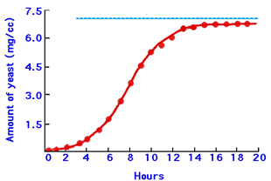
FOCUS LESSON : POPULATIONS INDEPENDENT PRACTICE
As with any growing city, construction in the Jacksonville area can mean that ecosystem areas needed for native animals and plants continue to shrink in size. For example, tortoises that burrow underground must be relocated to survive, as the weight of construction machinery and of new buildings will destroy the tunnels in which they find shelter. What will happen to the tortoises in the aftermath of the construction if no action is taken to save these animals?
Continuing with the previous question, as humans continue to impact the environment in which the tortoises live, describe the impact on the biotic and abiotic factors of the environment.
Elle and Shawn set up an experiment for Science Fair to see how yeast growth is affected under a variety of conditions. To begin their work, they set up a yeast culture in Elle’s kitchen using sugar as a food source. Their initial data is shown in the graph below, and gives the mass of yeast per cc or milliliter of culture. What information can you gather from the graph of their data provided?
What factors influence the carry capacity of populations?
Notes:
Answer: C

