Slide 1
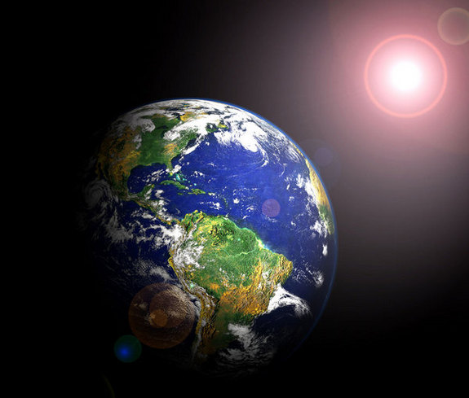
Ecological Change Focus Lesson Introduction
Our Earth is a very diverse planet. Why do we have such a wide range of diversity on our planet?

Slide 2
Ecological Change Focus Lesson Explicit Instruction
Earth’s axis and movement around the sun plays a key role in the variations amongst and within ecosystems.
Plants and animals are adapted to fit their surroundings and survive through the seasonal changes of their biomes.

Slide 3
Ecological Change Focus Lesson Explicit Instruction
Sometimes a disturbance occurs to an ecosystem causing changes.
After a significant disturbance either primary succession or secondary succession will occur.

Slide 4
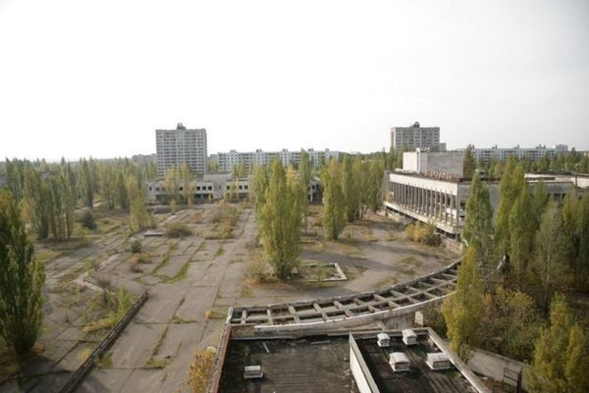
Ecological Change Focus Lesson Guided Practice
Suppose your city was abandoned. What would your city look like in a few hundred years?
Describe the events that would take place over time to your abandoned city.

Slide 5
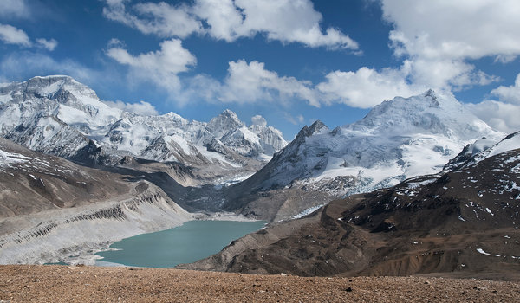
Ecological Change Focus Lesson Independent Practice
Suppose a glacier melts leaving newly exposed rock. Identify what type of succession will occur and describe the steps that would follow.
Ecologists used to think that each region had its own characteristic community determined by it’s climate. What factors besides climate can cause change to an ecosystem?

