Slide 1
FOCUS LESSON : OVERVIEW OF Human Impact INTRODUCTION
Salt water is an abundant resource but is unusable for irrigation and drinking. As demands on freshwater sources increase, the use of desalination processes to remove salt from ocean water is increasing. A concern of desalinating water is the large amounts of recovered salts that are returned to the ocean. Which of the following describes the most likely impact of desalination on the surrounding ocean environment?
Methane gas would pollute the ocean environment as shoreline organisms begin to die and decay.
Alteration in ocean salt levels would cause loss of species and unbalanced populations in marine food webs.
Nonrenewable resources in the ocean environment would become depleted and upset the ecosystem’s balance.
Increased levels of salts and minerals in the ocean would result in overpopulation of marine bivalves due to strengthened shells.

Slide 2
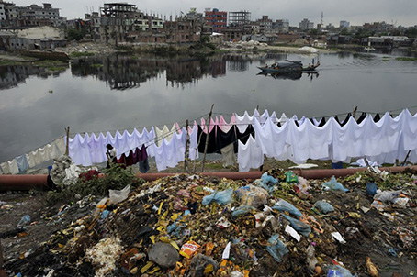
FOCUS LESSON : OVERVIEW OF Human Impact EXPLICIT INSTRUCTION
Production of materials for desired items use natural resources
Affluent societies will have a larger ecological footprint that poor societies.
They consume more energy, use more raw materials
Poor societies have a different negative affect on the environment.
They overuse land thereby depleting nutrients from the soil, causing soil erosion, and deforestation.
They contaminate the water supply through limited sanitation.

Slide 3
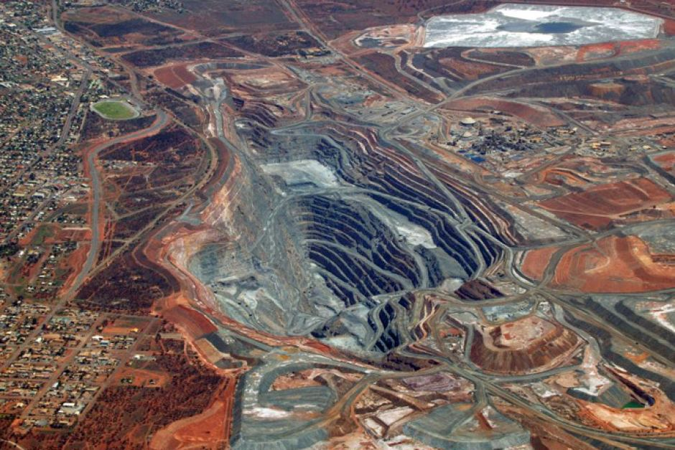
FOCUS LESSON : OVERVIEW OF Human Impact EXPLICIT INSTRUCTION
Other negative consequences from human influence:
Building construction – clears land and reduces natural habitats and biodiversity
Energy needs – reduce nonrenewable resources such as oil and coal; impacts climate change and global warming
Mining of raw materials – destroys land
Manufacturing and increased dependence on cars – pollutes air and water

Slide 4
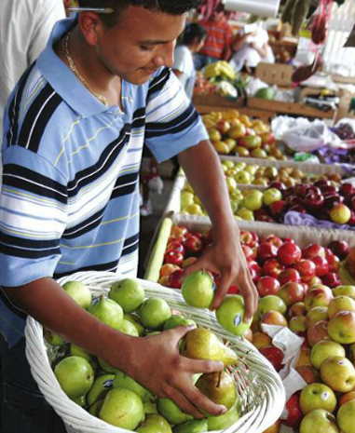
FOCUS LESSON : OVERVIEW OF Human Impact EXPLICIT INSTRUCTION
Sustainable practices:
Sustainable agriculture – use smaller amounts of pesticides, fertilizers, water, and energy for food production.
Buying local produce, reducing energy needed to bring the food to markets.
Recycling – reduces the use of petroleum, water, wood, and nonrenewable resources.
Sustainable forestry – planting of replacement trees and federal government protection of certain wildlife areas.
Use of more efficient and alternative energy practices.
Urban planning – use of mass transportation, green buildings, and adding parks and open spaces.

Slide 5
FOCUS LESSON : OVERVIEW OF Human Impact GUIDED PRACTICE
Read the summary of The Lorax.
List 5 ways that the Once-ler’s actions affected the local environment or others living there.
Describe 1 way to improve the area after the Truffula trees were gone (a sustainable practice).
Also available on video (original)

Slide 6
FOCUS LESSON : OVERVIEW OF Human Impact Independent Practice
Whaling was a very profitable profession until whale populations crashed. The global community came together to enact a ban on whaling. However, Japan and Norway have not agreed to stop whaling. What are the likely consequences of their decision?
When fertilizers run off farmland into streams and ponds, the nitrogen content of the water increases. This can lead to rapid growth of algae in a process called eutrophication. How can this process affect other organisms in the water? (Utilize your textbook glossary)
DDT and other pesticides used over 50 years ago are still affecting the environment today. Scientists have found these substances in recent glacier runoff. Glacier runoff occurs during the summer, when precipitation that has fallen on glaciers during the winter is released. Ice layers from existing glaciers have been analyzed. The results of this analysis show that the concentrations of DDT and other pesticides were highest about 10 years after the use of these substances was banned. What does this information tell us?

