Slide 1
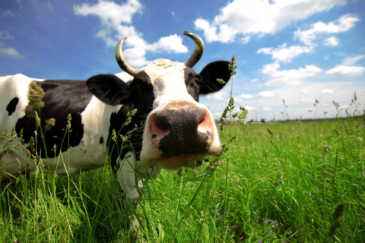
Cycles of Matter Focus Lesson
Introduction
A carbon atom in your fingernail today might have helped make up the muscle of a cow a year ago, may have belonged to a blade of grass a month before that, and may have been part of a dinosaur’s tooth 100 million years ago.
Considering the above paragraph, briefly describe how you think matter moves through the ecosystem.

Slide 2

Cycles of Matter Focus Lesson
Explicit Instruction
Matter may be transformed from one type to another, but may not be created or destroyed (Law of Conservation of Matter).

Slide 3
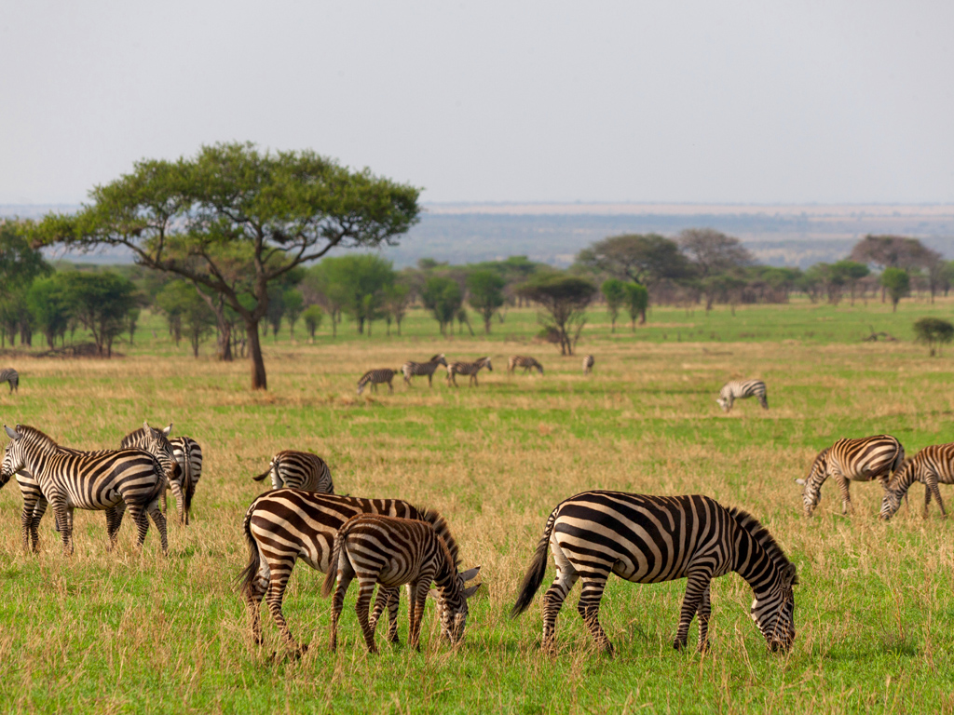
Cycles of Matter Focus Lesson
Explicit Instruction
Nutrients are matter that organisms require for their life processes.
Nutrients – such as carbon, oxygen, phosphorus, and nitrogen – circulate in our environment through biogeochemical cycles.

Slide 4
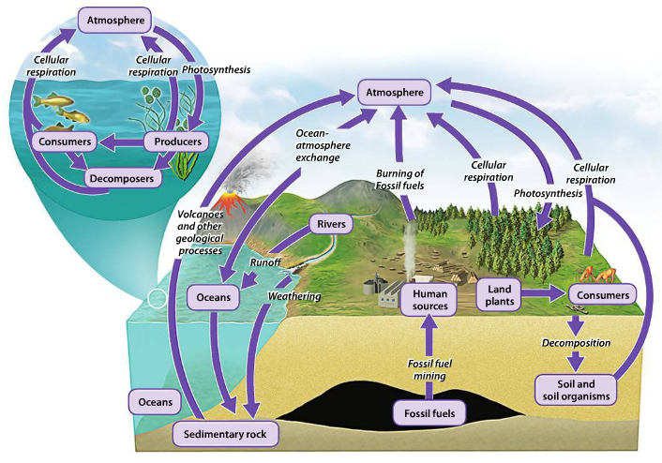
Cycles of Matter Focus Lesson
Explicit Instruction
Producers play vital roles in the cycling of carbon through the environment.

Slide 5
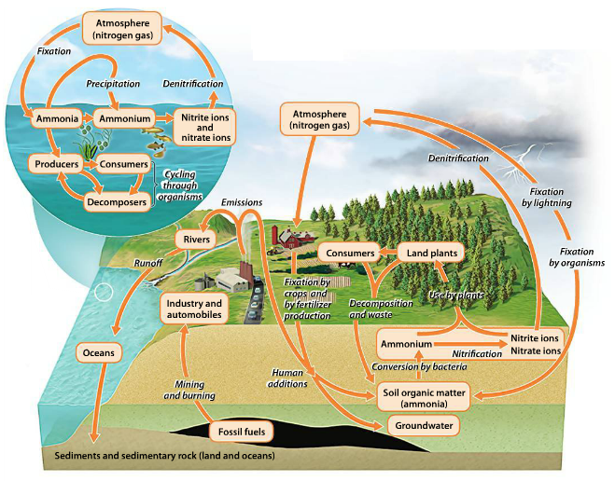
Cycles of Matter Focus Lesson
Explicit Instruction
The nitrogen cycle relies on bacteria that make nitrogen useful to organisms and bacteria that can return it to the atmosphere.

Slide 6
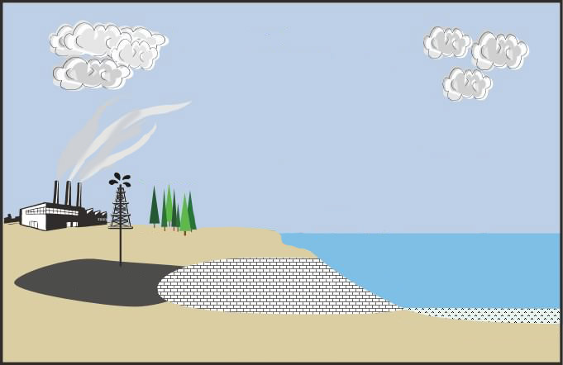
Cycles of Matter Focus Lesson
Guided Practice
Draw a diagram of the carbon cycle using arrows to show how carbon flows from one sphere to the next.
Include the following:
  Cellular Respiration
  Photosynthesis
  Burning of fossil fuels
  Ocean-Atmosphere exchange
  Weathering
  Runoff
  Decomposition
  Mining
ATMOSPHERE
HYDROSPHERE
GEOSPHERE

Slide 7
Cycles of Matter Focus Lesson
Independent Practice
Describe how photosynthesis and cellular respiration help drive the carbon cycle.
Using a multi-directional flow diagram (as shown to the right), explain how the atmosphere, geosphere, and hydrosphere play a role in the water cycle.
Explain the role nitrogen fixation, nitrification, and denitrification play in the nitrogen cycle.
Atmosphere
Hydrosphere
Geosphere

