Slide 1
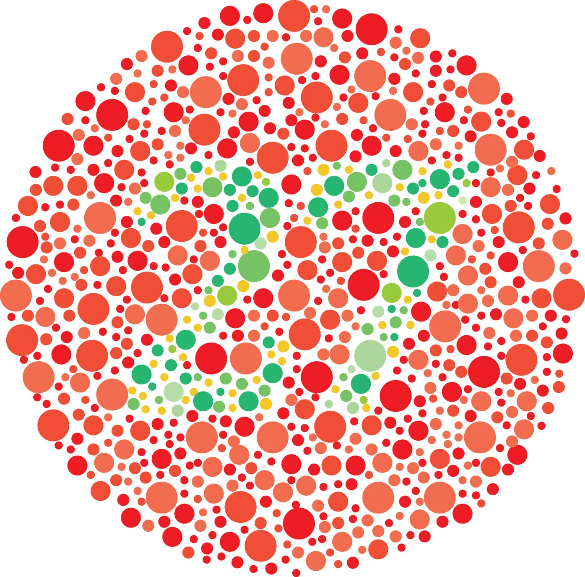
Focus Lesson : Heredity
Introduction
Red/green color blindness is a sex-linked, recessive trait. Which of the following describes the probability of color blindness in the offspring of a man who does not have color blindness and a woman who is a heterozygous carrier?
A. There is a 25% chance that their sons will have color blindness .
B. There is a 100% chance that their sons will have color blindness.
C. There is a 0% chance that their daughters will have color blindness.
D. There is a 50% chance that their daughters will have color blindness.

Slide 2
How do genes influence the variety of organisms that exist?
SC.912.L.16.1 - Use Mendel’s laws of segregation and independent assortment to analyze patterns of inheritance.

Slide 3
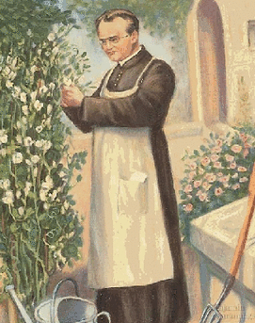
Focus Lesson : Heredity
Explicit instruction
Gregor Mendel laid the groundwork for genetics
  Law of Segregation:
    Organisms inherit two copies of each gene, one from each parent.
    Organisms donate only one copy of each gene in their gametes, where each gene segregate during gamete formation.
  Law of Independent Assortment:
    Allele pairs separate independently of each other during gamete formation (meiosis).

Slide 4
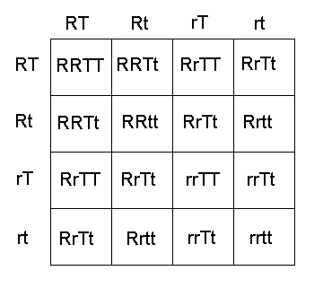
Focus Lesson : Heredity
Explicit instruction
Genes influence the development of traits, where there may be multiple versions (alleles).
Dominant alleles are expressed when present, and recessive alleles are expressed generally when two copies are present.
A Punnett square is a grid system used to predict the possible genotypes of each parent.
A dihybrid cross may also be used to examine inheritance of two different traits.

Slide 5
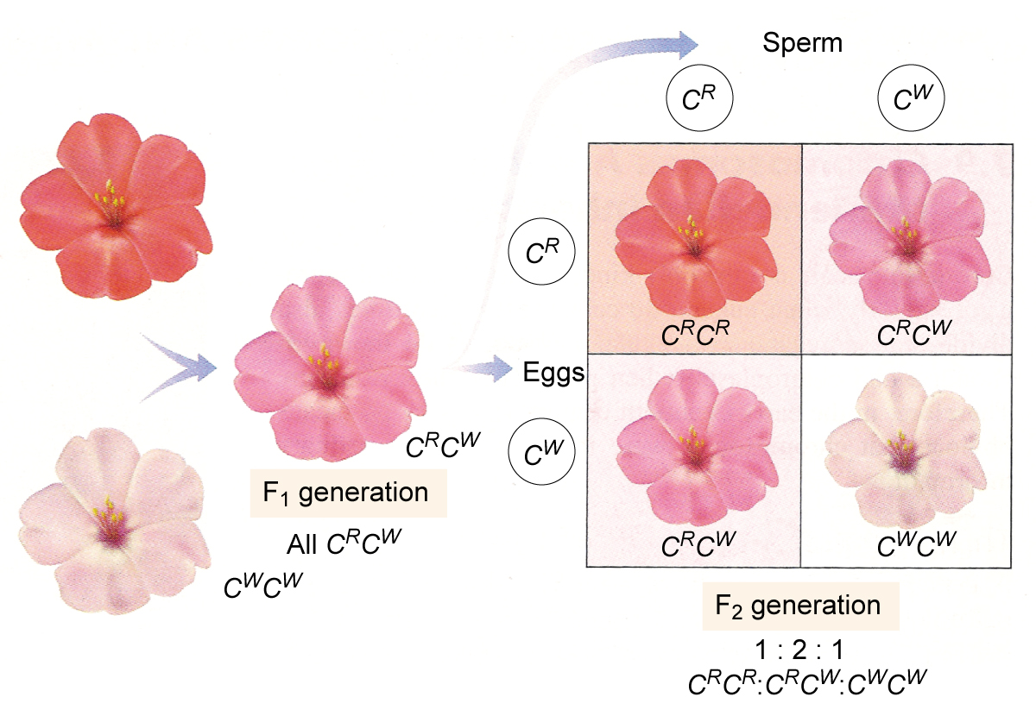
Focus Lesson : Heredity
Explicit Instruction
Some traits are neither dominant nor recessive resulting in incomplete dominance.
Some traits have multiple dominant alleles resulting in codominance.
Some traits are controlled by multiple genes resulting in polygenic traits.
Some traits are located on the sex chromosomes (X or Y) and thus sex-linked genes.

Slide 6
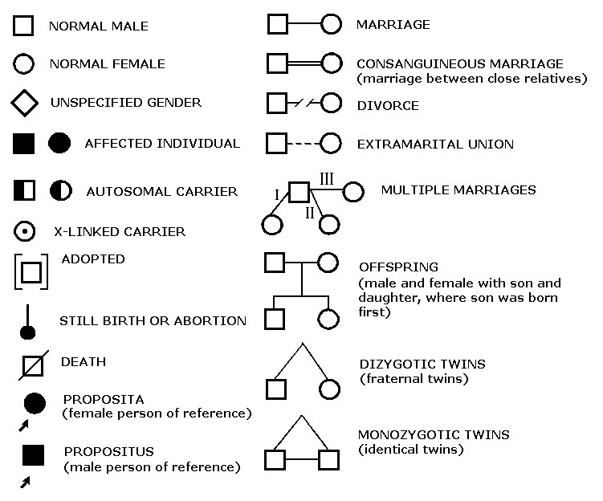
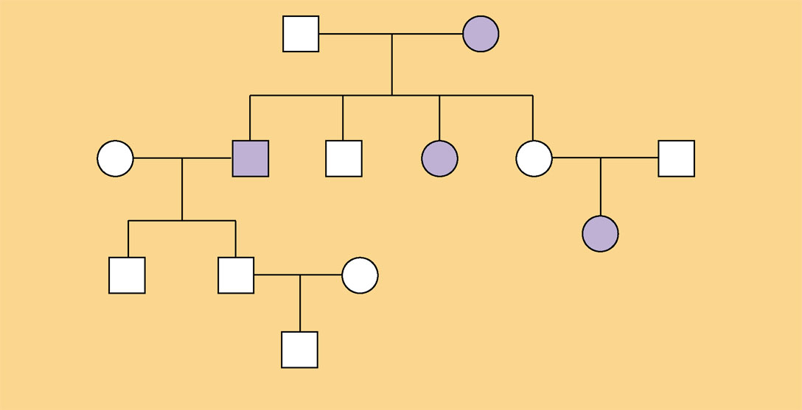
Focus Lesson : Heredity
Explicit Instruction
  Pedigree charts show the relationship within a family and can be used to track a particular trait.
George
Arlene
Sandra
Tom
Sam
Wilma
Ann
Michael
Carla
Daniel
Alan
Tina
Christopher

Slide 7
Focus Lesson : Heredity
Guided Practice
Complete the monohybrid cross:
X^{C}X^{c} * X^{C}Y
X^{C} = normal, X^{c} = colorblind, Y = no allele
X^{C}X^{C} = normal female
X^{C}X^{c} = carrier female
X^{c}X^{c} = colorblind female
X^{C}Y = normal male
X^{c}Y = colorblind male
What are the phenotype possibilities of the offspring?
 | X^{C} | X^{c}
X^{C}
Y

Slide 8
Focus Lesson : Heredity
Guided Practice
Complete the following dihybrid cross:
RRTt x Rrtt
RR & Rr = Red; rr = white
TT & Tt = tall; tt = short
What are the phenotype ratios?
  Red & Tall:
  Red & Short:
  White & Tall:
  White & Short:
 | RT | Rt | RT | Rt
Rt | RRTt | RRtt |  | RRtt
Rt |  | RRtt
rt |  |  | RrTt
rt | RrTt

Slide 9
Focus Lesson : Heredity
Guided Practice
  Consider we are tracking a recessive, autosomal disorder. Which of the following people do we know are carriers?
George
Arlene
Sandra
Tom
Sam
Wilma
Ann
Michael
Carla
Daniel
Alan
Tina
Christopher

Slide 10
Focus Lesson : Heredity
Independent Practice
Complete the monohybrid cross shown to the right, where the mother and father are both heterozygous (Gg) for the green (G) trait.
Identify the genotype and phenotype ratios for the four possible offspring, where GG is homozygous dominant (green), Gg is heterozygous (green), and gg is homozygous recessive (yellow).
What type of dominance is exhibited?
 | G | G
G
g

Slide 11
Focus Lesson : Heredity
Independent Practice
Complete the dihybrid cross shown to the right, where the mother is homozygous for green and heterozygous for tall (GGTt), and the father is homozygous recessive for yellow and heterozygous for tall (ggTt).
GG & Gg = Green; gg = yellow
TT & Tt = tall; tt = short
What are the phenotype ratios?
  Green & Tall:
  Green & Short:
  Yellow & Tall:
  Yellow & Short:
 | GT | Gt | GT | Gt
gT | GgTT |  | GgTT
gt | GgTt | Ggtt | GgTt | Ggtt
gT |  | GgTt | GgTT
gt | GgTt | Ggtt |  | Ggtt

