Slide 1
Focus Lesson : Mechanisms of Change Introduction
A species of mockingbird lives in the Apalachicola National Forest. One year, a few of the mockingbirds were born with very long beaks. Over the next several years, the area experienced particularly cold winters. The weather forced the insects in the area to burrow deeper into the ground. Surveys of the mockingbird population showed that the number of long-beaked mockingbirds had increased. What would account for this increase in the number of long-beaked mockingbirds?
Short-beaked mockingbirds migrated to warmer climates.
Short-beaked mockingbirds became food for other animals.
Long-beaked mockingbirds were able to reach food and survived.
Long-beaked mockingbirds were able to stay warmer during the cold winters.

Slide 2
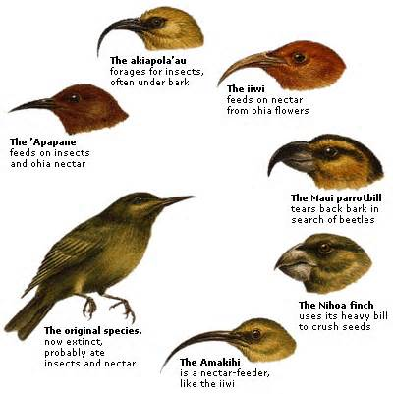
How can a change in the environment initiate a change in a population?
SC.912.L.15.13 Describe the conditions required for natural selection, including: overproduction of offspring, inherited variation, and the struggle to survive, which result in differential reproductive success.

Slide 3
Focus Lesson : Mechanisms of Change Explicit Instruction
Mechanisms of Evolution:
Mutations – changes in DNA that introduces genetic variation.
Migration – a disproportionate group enters/leaves the population.
Genetic Drift – an unusual event separates all but a few individuals of a population.
Natural Selection – traits that improve chance for survival and reproduction are passed more frequently to offspring.

Slide 4
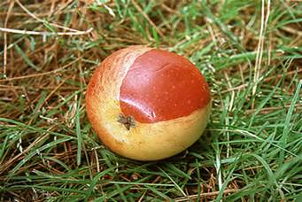
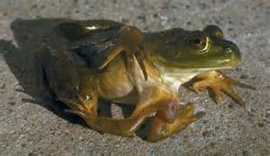
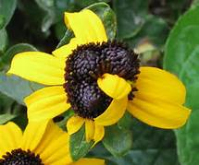
Focus Lesson : Mechanisms of Change Explicit Instruction
A mutation is a change in an organism’s nucleotide sequence.
The change may occur in a gene or in a chromosome.
Mutations may be benefit, hinder, or have no affect on the organism’s ability to survive and reproduce.

Slide 5
Focus Lesson : Mechanisms of Change Explicit Instruction
Migration between populations may change the gene pool of the population.
Suppose Western Deer fur color is homozygous recessive (bb) while Eastern Deer fur color is homozygous dominant (BB).
Interbreeding with migrating deer would change the allele frequency of the population.

Slide 6
Focus Lesson : Mechanisms of Change Explicit Instruction
Genetic drift occurs when an unusual event separates all but a few individuals from the rest of the population.
For example, a natural disaster could decimate a population of birds.
The original population could have been 60% yellow and 40% blue.
The surviving population could have been 70% blue and 30% yellow.

Slide 7
Focus Lesson : Mechanisms of Change Explicit Instruction
Conditions for Natural Selection
More offspring than can survive.
Individuals of a species have variation.
Variation gives reproductive advantage.

Slide 8
Focus Lesson : Mechanisms of Change Guided Practice
SCENARIO 1 : WORMS
There are 2 types of worms: worms that eat at night (nocturnal) and worms that eat during the day (diurnal). The birds eat during the day and seem to be eating ONLY the diurnal worms. The nocturnal worms are in their burrows during this time. Each spring when the worms reproduce, they have about 500 babies but only 100 of these 500 ever become old enough to reproduce.
Over production:
Types of variation:
Favorable trait:
Surviving trait:

Slide 9
Focus Lesson : Mechanisms of Change Guided Practice
SCENARIO 2 : POLAR BEARS
There are 3 types of polar bears: ones with thick coats, ones with thin coats and ones with medium coats. It is fall, soon to be winter. The temperatures are dropping rapidly and the bears must be kept warm, or they will freeze to death. Many of the bears have had ~2 cubs each but due to the extreme temperatures, many mothers only have one cub left.
Over production:
Types of variation:
Favorable trait:
Surviving trait:

Slide 10
Focus Lesson : Mechanisms of Change Guided Practice
SCENARIO 3 : OSTRICHES
In ostriches, there are 2 types: ones that run fast and those that run slowly. The fast birds can reach up to 40 miles an hour. Jackals love to eat ostrich, and they can reach speeds of up to 35-40 miles per hour. A flock of ostrich will lay ~ 10 eggs (each mother only lays 1), but many rodents break into the eggs and eat the fetus before they hatch.
Over production:
Types of variation:
Favorable trait:
Surviving trait:

Slide 11
Focus Lesson : Mechanisms of Change Independent Practice
Why would a deer be more likely to eat the left cactus than the right cactus?
In figure 3, the right cactus has flowers, but the cactus that has been eaten by the deer is too damaged to make flowers. Figure 4 shows the situation several months later. What has happened?
Do you think that evolution by natural selection is occurring in this cactus population? Explain why or why not.
What adaptation seems to increase the fitness of the cacti on the right? How do you think this adaptation increases the ability of cacti on the right to survive and reproduce?
Extension:
Assume that in the cactus population, the presence of thorns is a recessive characteristic. Will the frequency of the allele for thorns become greater or lesser over time?

Slide 12
Focus Lesson : Mechanisms of Change Check for Understanding #1
A subspecies is a different group within a species that is able to interbreed but is usually prevented from doing so by geographical isolation. The Florida Panther is a subspecies of the American Cougar, and there are very few (less than 100) remaining in its population. When populations get this small, inbreeding results in low genetic diversity. The result is fewer beneficial adaptations that might help the animals survive environmental change, as well as an increase in the occurrence of genetic abnormalities. How can this subspecies of cougar be saved from extinction?
Keep the existing population in a controlled environment until their population increases.
Increase the genetic diversity by introducing other subspecies of cougar to the population.
Relocate remaining Florida Panthers to the larger populations of cougar subspecies in Texas and California.
Remove all the panthers with genetic abnormalities from the environment and leave only the healthy ones.

Slide 13
Focus Lesson : Mechanisms of Change Check for Understanding #2
Florida Panthers are an endangered species. Because the remaining population of Florida Panthers is quite small and fairly closely related, there are concerns that there is not enough genetic variability within the population. How does greater genetic variability within the population affect the Florida Panthers' reproductive success?
It reduces the need to keep Florida Panthers alive in captivity.
It increases the rate of mutations that create helpful adaptations.
It reduces the expansion of harmful traits that result from inbreeding.
It increases the chance that the Florida Panther will be able to survive sea level rise.

Slide 14
Focus Lesson : Mechanisms of Change Check for Understanding #3
Natural selection is a process that results in change within a species over time. Which of the following is NOT a condition required for natural selection to result in speciation?
overpopulation of the species
genetic equilibrium of the species
genetic variation within the species
competition for survival within the species

Slide 15
Focus Lesson : Mechanisms of Change Home Learning
An organism’s fitness describes how well it is adapted to its environment. The environment is made of biotic and abiotic factors. Explain whether it is mostly the biotic or abiotic components of the fish’s environment that are affecting their survival and reproductive success.

