Slide 1
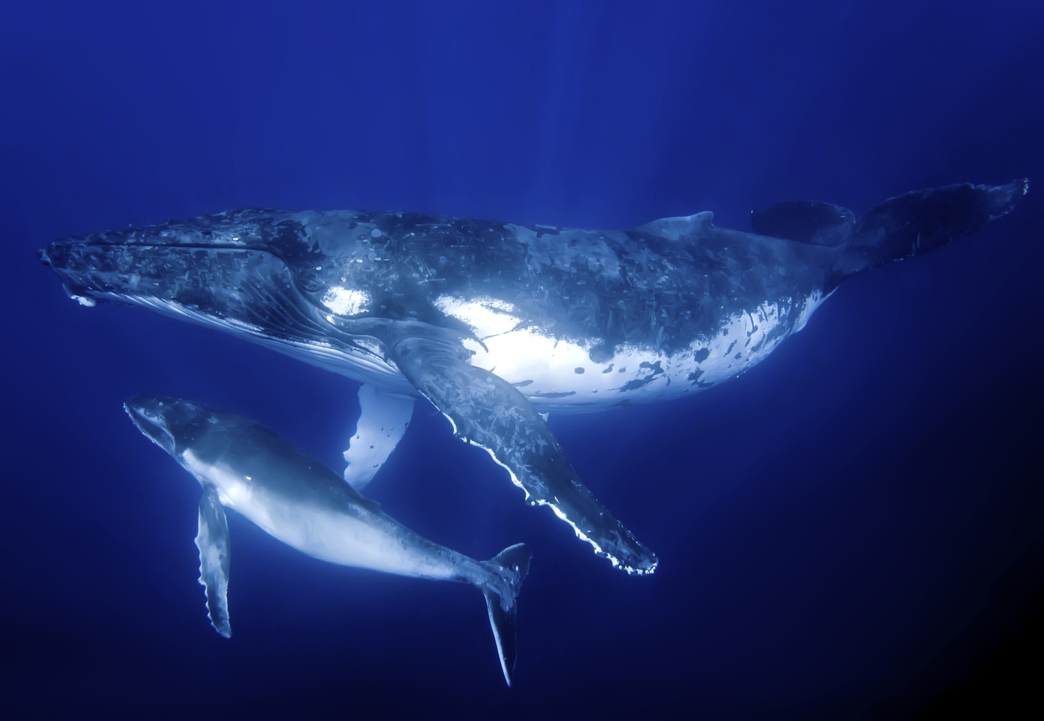
Population Growth
Complete Cornell Notes + for Chapter 4, Lesson 3
Be sure to write the summary using the “10 Most Important Words” method.
Complete the “Reading Checkpoint” questions as you go (on a separate sheet to turn in).
Complete the “Lesson 3 Assessment” Questions 1-4 (on the same separate sheet to turn in).

