Slide 1
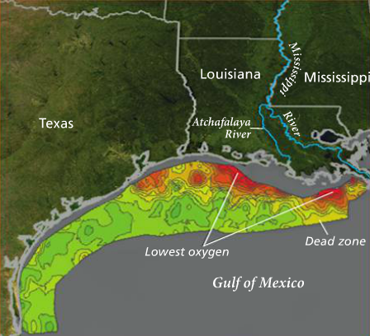
The Carbon Cycle
Introduction
Using your textbook, read “The Gulf of Mexico’s Dead Zone” on page 63.
Answer the following question:
How do the non-living parts of Earth’s systems provide the basic materials to support life?

Slide 2
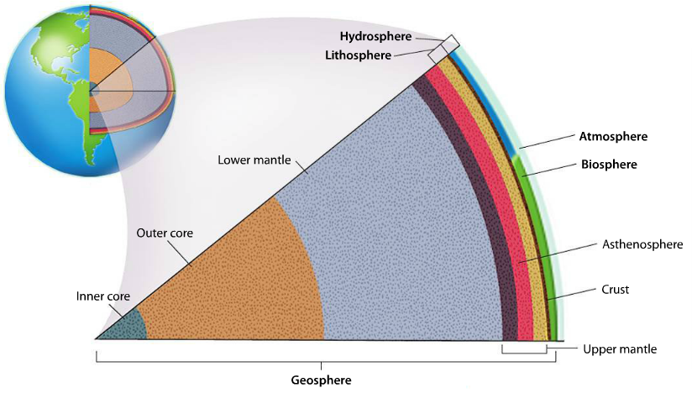
The Carbon Cycle
Explicit Instruction
Earth’s systems include cycles that influence life and climate on our planet.
Earth’s geosphere, lithosphere, biosphere, atmosphere, and hydrosphere are defined by their functions.
Biosphere consists of all of the living (or once-living) things and the non-living things they interact with.
The atmosphere consists of all the gases that surround our planet.
The hydrosphere encompasses all of the water on Earth’s surface, underground and in the atmosphere.

Slide 3
The Carbon Cycle
Explicit Instruction
Nutrients cycle through the environment endlessly.
Law of Conservation of Matter explains:
  Matter cannot be created or destroyed
  Matter may be transformed from one type to another.
Nutrients are matter that organisms need to survive.
Nutrients cycle through the environment in complex cycles called biogeochemical cycles.
  e.g. water, carbon, nitrogen, phosphorus & oxygen.

Slide 4

The Carbon Cycle
Guided Practice
On a sheet of paper draw three even boxes as show to the right. Be sure to leave enough space below and around the boxes.
The top box represents the sphere with the most carbon, while the bottom box represents the sphere with the least carbon.
Label each of the three boxes either biosphere, atmosphere or hydrosphere based on which your group believes to have the most-to-least carbon.
Draw arrows from one sphere to another and label the process that moves the carbon atom. Label the arrow indicating the process.
e.g. fossil fuels (biosphere) → (burning) → atmosphere

Slide 5
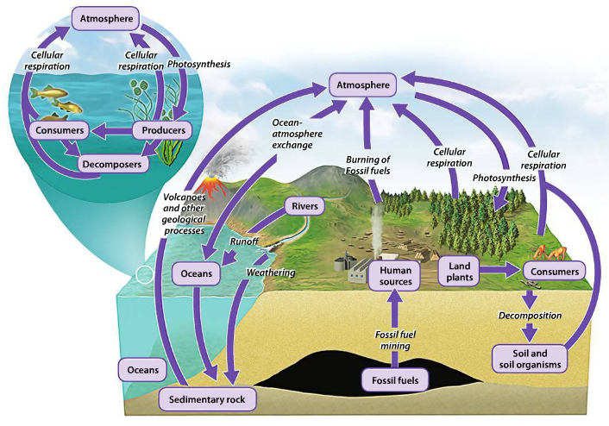
The Carbon Cycle
Guided Practice
Spheres with most-to-least carbon:
  Hydrosphere → Biosphere → Atmosphere

Slide 6
The Carbon Cycle
Independent Practice
Why is Earth’s biosphere called “the living Earth?”
What is ozone and how does it affect our atmosphere? How do greenhouse gases in Earth’s atmosphere affect our environment?
How are salt water and freshwater distributed on Earth? Describe two human activities that affect the water cycle.
How do organisms in the biosphere affect the atmosphere and vice versa?
Describe how photosynthesis and cellular respiration helps drive the carbon cycle. Why do scientist think that there is a carbon sink somewhere?

Slide 7
The Carbon Cycle
Home Learning
Performance Task: Imperiled Species Management Plan:
  It will be your task to create a species action plan for a threatened or endangered species native to the State of Florida or the southeastern region of the United States.
    For the three species you have identified find the following information:
      What are some strategies that you can implement to reach your conservation objective?
        What regulations could be imposed by a governmental agency (EPA, FWC, etc), including bans on hunting/killing, hunting/fishing permits, building permits, etc?
        What actions could be taken by other governmental agencies to protect or better manage factors effecting the species?
        What sort of incentives could be given to encourage those using public or private lands to comply with government regulations?
        What sort of plan could be implemented to monitor the species in the future?
        What sort of education or outreach could be implemented to improve public knowledge of the species and threats to the species?
        What future research would or could improve conditions for the species’ survival?

