Slide 1
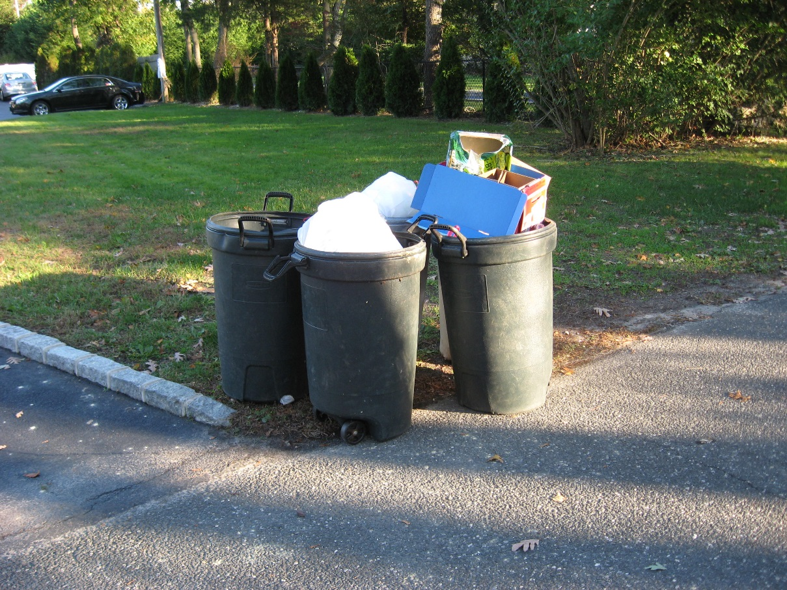
International Environmental Policy
Introduction
Every week trash goes out to the curb for pick up. Your neighbor’s trashcans are in ill-repair. Each week they fall over and trash spills over into your yard. The trash men leave it.
On rainy nights some of that trash washes down the gutters into your yard further and even into the drains next to your house.
Since the city drain rests on your property the city has levied fines on you since they have had to come out to clean out the drain. How could you resolve this issues (without violence)?

Slide 2
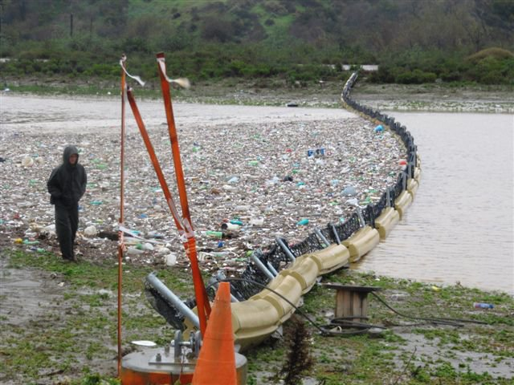
International Environmental Policy
Explicit Instruction
Environmental problems may involve more than one nation (trans-boundary problems).
  Rivers flow through more than one nation, carrying pollution across the border. (Tijuana River)
  Air pollutants emitted by one nation is carried by wind currents across the globe.
  Migrating animals cross borders, on both land and by sea. (Over-hunting/fishing)
  Multinational companies operate outside of national laws (disregard sustained practices)

Slide 3
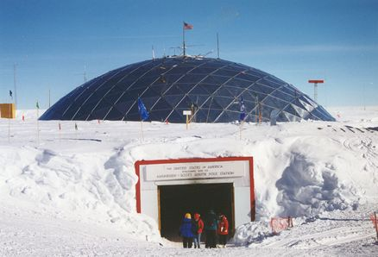
International Environmental Policy
Explicit Instruction
International laws or treaties may emerge from multinational conventions:
  Antarctic Treaty System (1959): restricts Antarctica to peaceful purposes and scientific research.
  CITES (1975): ensures international trade will not threaten the survival of a species.
  Montreal Protocol on Substances That Deplete the Ozone Layer (1987): restricts the production of chemicals that deplete the ozone layer.
  Kyoto Protocol (1997): agreeing nations promised to reduce emissions of six greenhouse gases to levels below those of 1990.

Slide 4

International Environmental Policy
Explicit Instruction
  Organizations may pass laws, sign treaties or influence behavior of nations:
    (UN) United Nations: 190 member nations, helps write international environmental policy.
    (EU) European Union: 27 member nations, provides environmental data and analysis to European policy makers.
    (WTO) World Trade Organization: promotes free trade, enforces fair trade practices, and may impose financial penalties.
    World Bank: 186 member nations, provides funding to improve living standards.
    (NGOs) Non-Governmental Organizations: Organizations such as Greenpeace, Population Connection, and Conservation International shape policy through research, lobbying, education and protests.

Slide 5
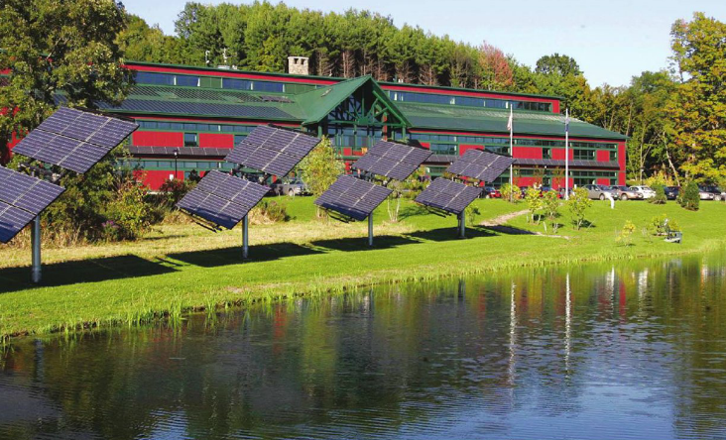
International Environmental Policy
Explicit Instruction
Approaches to environmental policy may include direct laws or policies with incentives.
  A command-and-control approach, where governments threaten punishment for violations, has widely been used.
    This process fails when policy is non-well informed or gov’t fails to enforce.
  Governments may provide subsidies, cash or resources, to encourage a particular activity or lower the product price.
  A green tax may also be imposed on items that are harmful to the environment.
  Governments also may impose a cap-and-trade system, in which the government determines an acceptable level of pollutants.
  Local incentives, such as tax breaks or rebates, may also be given for buying particular environmental friendly items.

Slide 6
International Environmental Policy
Guided Practice
Review the Environmental Policy Process on pages 53 – 55 in your textbook.
Summarize. Describe the environmental policy process from identification of a problem through enactment of a federal law.
How is this process similar to the scientific method?

Slide 7
International Environmental Policy
Independent Practice
Why are international environmental laws are needed? What are trans-boundary problems?
What role does (NGOs) non-governmental organizations play in international environmental policy making? What are some examples of NGOs?
Governments can use taxes both to encourage compliance with environmental policies
and to discourage noncompliance. Give an example of each.

Slide 8
International Environmental Policy
Home Learning
Performance Task: Imperiled Species Management Plan:
  It will be your task to create a species action plan for a threatened or endangered species native to the State of Florida or the southeastern region of the United States.
    For the three species you have identified find the following information:
      Scientific name
      Life history and habitat range
      Distribution and population status (map data may be included)
      Historic and ongoing conservation efforts
    For the three species you have identified find the following information:
      Why the species should be listed as threatened or endangered
      What the present or anticipated threats to its survival are

