Slide 1

US Environmental Policy
Introduction
Identify policies or rules that are in effect in our school community. What are the goals of these policies? How do they keep students safe? How do they promote learning?

Slide 2
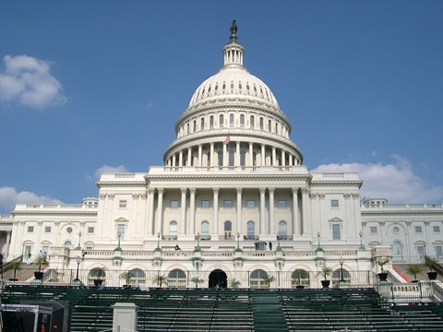
US Environmental Policy
Explicit Instruction
Environmental policy consists of plans and principles that address interactions between humans and the environment.
Government works with citizens, organizations and businesses to make environmental policy.
  Laws are proposed to and passed by the legislative branch.
  Enacted legislation is put into action and enforced by executive agencies (i.e. EPA, US Forest Service, National Resource Conservation Service, etc.)
  Lawsuits help ensure corporations and gov’t agencies comply, and are used to challenge infringement of environmental laws on rights.

Slide 3
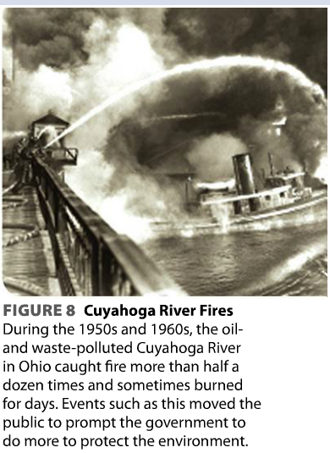
US Environmental Policy
Explicit Instruction
The relationship between US goals and the environment has changed over time.
  First Period (1780s to late-1800s)
  Laws primarily dealt with mgmt. of public lands (Westward Expansion, Native American Relocation)
  Second Period (late-1800s to mid-1900s)
  Laws dealt with negatives effects of westward expansion (Forest Reserve Act of 1891 and Wilderness Act of 1964)
  Third Period (mid-to late-1900s)
  Public priorities and public policy shifted toward environment conservation (see Cuyahoga River Fires).

Slide 4

US Environmental Policy
Explicit Instruction
Modern US environmental policy reveals past misuses and strives for a sustainable future.
  National Environmental Policy Act (1970)
    Created the Council on Environmental Quality
    Required (EIS) Environmental Impact Statements for any major federal action.
  Environmental Protection Agency
    Created through an executive order by President Nixon
    Regulates water quality, air pollution and solid waste disposal.

Slide 5
US Environmental Policy
Modeling
Science
Economics
Ethics
Science provides information and analysis needed to identify, understand, and devise solutions for problems.
Ethics offers criteria on how a society should address a problem.
Economics considers how the problem may be addressed with sustainability of the system in mind.
Ex. Federal Water Pollution Acts of 1948 and 1972, and later the Clean Water Act.

Slide 6
US Environmental Policy
Guided Practice
Create a timeline for the following events that helped shape us environmental policy. What does this timeline tell you about US Environmental Policy over the years?
  Land Ordinances (1785)
  Northwest Ordinance (1787)
  Homestead Act (1862)
  General Mining Law (1872)
  Forest Reserve Act (1891)
  National Park Service (1916)
  Environmental Conservation Work Act (1933)
  Cuyahoga River Fires (1950s – 1960s)
  Silent Spring (1962)
  Wilderness Act (1964)
  National Environmental Policy Act (1969)
  Environmental Protection Agency (1970)
  Earth Day (1970)
  Marine Mammal Protection Act (1972)
  Safe Drinking Water Act (1974)
  Toxic Substances Control Act (1976)
  Soil and Water Resources Conservation Act (1977)
  Clean Water Act (1977)
  “Superfund” (1980)
  Food Security Act (1985)
  Pollution Prevention Act (1990)
  Food Quality Protection Act (1996)

Slide 7
US Environmental Policy
Independent Practice
Identify three goals of modern-day environmental policy. Name five individuals and groups that help make environmental policies.
How do environmental catastrophes tend to influence environmental policies in state and local governments? Provide an example.
How did Rachel Carson’s Silient Spring help change US environmental policy?
How does environmental policy become law in the United States?
You may have heard of titles that historians have given specific periods in history such as Pax Romana, the Renaissance, and the Victorian Era. What title would you give to each of the three periods of US environmental policy discussed in this lesson? Explain your choices.

Slide 8
US Environmental Policy
Home Learning
Performance Task: Imperiled Species Management Plan:
  It will be your task to create a species action plan for a threatened or endangered species native to the State of Florida or the southeastern region of the United States.
    For the three species you have identified find the following information:
      Scientific name
      Life history and habitat range
      Distribution and population status (map data may be included)
      Historic and ongoing conservation efforts
    For the three species you have identified find the following information:
      Why the species should be listed as threatened or endangered
      What the present or anticipated threats to its survival are

