Slide 1
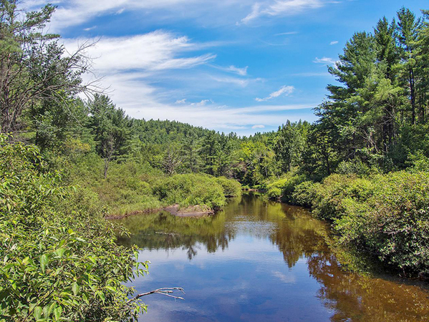
Economics
Introduction
What makes a partial of land valuable? List out several criteria that you believe makes land more valuable than others. Explain why you believe that criteria gives land value.

Slide 2
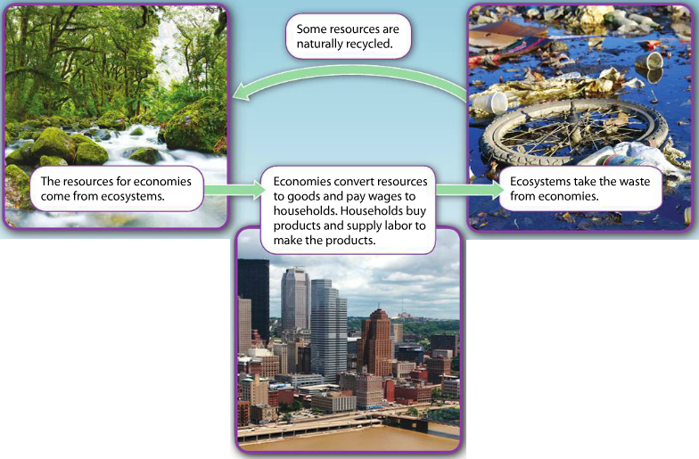
Economics
Explicit Instruction
Economics is the study of how resources are converted into goods and services, distributed and used.
All economies depend on the environment for resources and for management of wastes.
  Natural resources are “goods” produced by nature (e.g. water, trees, fossil fuels, etc.)
  Ecological systems provides “ecological services” (e.g. purify air & water, cycle nutrients, waste breakdown & recycling)
  Overuse or pollution may deplete available resources or harm ecological systems.

Slide 3
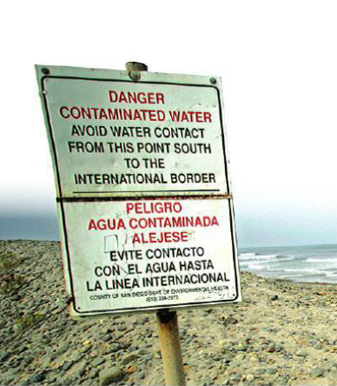
Economics
Explicit Instruction
The relationship between economics and the environment is often overlooked.
  Economists tend to assume that costs & benefits only affect buyers and sellers.
  Short-term often outweighs the long-term leaving future generations with the problem.
  Economists do not consider that resources can run out.
  Limited resources means that continued economic growth is not sustainable.

Slide 4
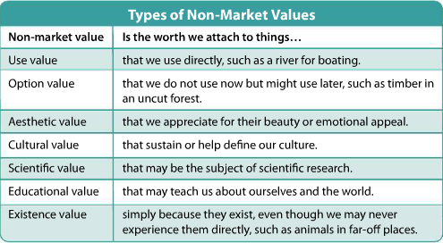
Economics
Explicit Instruction
Economics need to learn how to conserve resources and reduce environmental harm.
  Ecological economics argues that economies don’t grow or shrink, rather they are stable and sustainable.
  Environmental economics focuses on environmental issues, assigning value to ecosystem services.

Slide 5
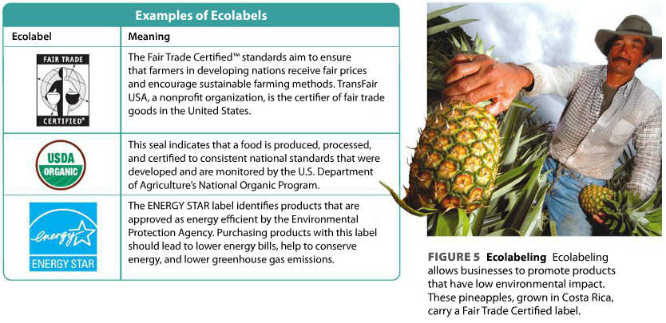
Economics
Modeling
Changing customer values helps drive corporations to pursue sustainable goals.
Ecolabeling helps consumers find more environmental economic products.

Slide 6
Economics
Guided practice
Do you think we should attempt to quantify and assign market values to ecosystem services and other entities that have only non-market values? Why or why not?
What non-market value would you put the most value on? Least value? Why?

Slide 7
Economics
Independent Practice
Summarize. What is the expected outcome of the relationship between supply and demand? What is the goal of a cost-benefit analysis?
Relate Cause and Effect. Describe four assumptions traditionally made in economics that can have a negative effect on the environment.
Infer. What are two benefits that a company can achieve by operating its business in an environmentally sustainable way?

Slide 8
Economics
Home Learning
Performance Task: Imperiled Species Management Plan:
  It will be your task to create a species action plan for a threatened or endangered species native to the State of Florida or the southeastern region of the United States.
    For the three species you have identified find the following information:
      Scientific name
      Life history and habitat range
      Distribution and population status (map data may be included)
      Historic and ongoing conservation efforts

