Slide 1
The Community of Science
Introduction
New Calgary, a growing town of 655,000 people in the north, has exceeded the water usage of their local lake. In an effort to provide more water for New Calgary the locals have voted to divert river water from the Timmons River to Lake Yosemite. The amount of water diverted has projected to support another 500,000 residents, to meet the projected growth of the city over the next 20 years.
However, local environmentalists warned the city council that diversion of the river would cause harm to the surrounding ecosystem. The environmentalists provided data that showed a projected decrease in the native mussel population and land animals that rely on these mussels for food.
After further environmental study the council was presented with data that the only environmental harm would be the loss of 45% of the local mussel population and the likely endangerment of two land species.
As a voting member of the New Calgary City Council would you vote to support the diversion of the water from Timmons River or against the proposal? What explanation would you provide to your constituents as to why you voted in that direction?

Slide 2
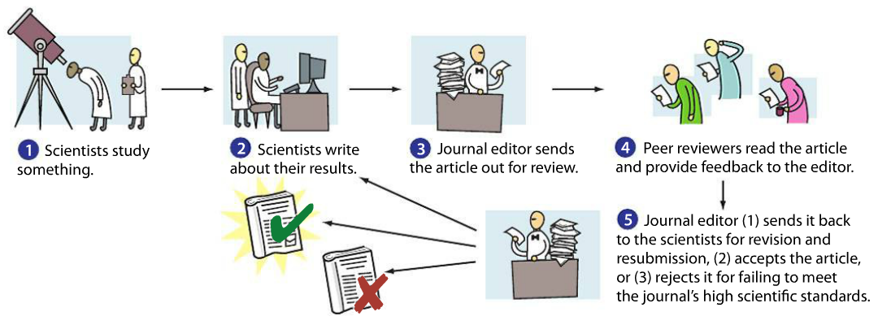
The community of Science
EXPLICIT INSTRUCTION
The scientific community helps verify the accuracy of results and establishment of scientific theories.
  Peer Review is a formal way a researcher may get comments and criticism from the scientific community.
  Scientists will attempt to replicate the findings of an experiment before the community accepts explanations.
  Science is self-correcting, in that new data is constantly being discovered or new explanations improved.

Slide 3
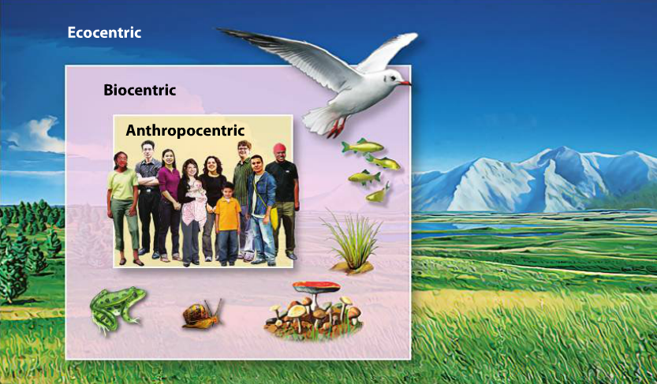
The Community of Science
EXPLICIT INSTRUCTION
Environmental ethics explores how environmental science interacts with a society’s morals and principles.
  Ethics is a branch of philosophy that studies and refers to the moral principles or values held by a person or society.
  People of different cultures – knowledge, beliefs, values and ways of life – may differ in their ethical standards.
  Environmental ethics arose when humans became aware of the environmental changes brought about by the industrial revolution.
    Anthropocentrism – human centered view of the environment.
    Biocentrism – value is given equally to all living things, human and non-human.
    Ecocentrism – benefit or harm of the whole ecosystem, living and non-living, are more important than the individual or species.

Slide 4
The Community of Science modeling
Can You Repeat That?
Draw a line on your paper one inch straight down.
Draw a line on your paper starting at the top of the first line one inch to the right.
Draw a line on your paper connecting the bottom tip of the first line to the right tip of the second line.
Draw a line starting at the middle of the third line diagonally, to where it is equal to the bottom-most and right-most points of your drawing so far.
Draw a line dividing the triangle formed by the first three lines in half.

Slide 5
The Community of Science modeling
Can You Repeat That?
Draw a line for each of the two formed right triangles that divides the two right triangles into equal halves.
Shade in the bottom left-most right triangle.
Shade in the top left-most right triangle.
Make a period-sized dot on the top left-most point of the drawing.
Make a period-sized dot on the bottom right-most point of the drawing.

Slide 6
The Community of Science
Guided practice
Can You Repeat That?
Together with your partner, write out 10 directions that designs an object on your sheet of paper. Draw the diagram also for your pair for reference.
Give your directions to a group NEXT TO you. See if they can replicate your team’s drawing. They may not see your original design, nor may they ask questions.
Compare your original design to the replicated design.
Analyze and Conclude:
Evaluate and Revise. Identify the places where you could have written clearer instructions. Revise your instructions and swap with another team. Did the instructions work better the second time?
Infer. Why is it important that procedures be included in published scientific papers?

Slide 7
The Community of Science
INDEPENDENT PRACTICE
Your doctor recommends that someone in your family start taking a new drug to lower cholesterol. Where would you recommend looking for information: articles published in peer-reviewed journals or materials published by the drug company? Explain your answer.
Why is replication of results important and how do they contribute to the development of scientific theories?
Explain how ethics could impact a government’s policy on science. What does the environmental justice movement promote?
What is the relationship between culture and worldview? What role do society’s beliefs play in an objective process like science?
Which ethical standard do you agree with the most; anthropocentrism, biocentrism or ecocentrism? Why? (Be sure to explain the principles of that ethical standard in your answer)

Slide 8
The Community of Science
HOME LEARNING
Performance Task: Imperiled Species Management Plan:
  It will be your task to create a species action plan for a threatened or endangered species native to the State of Florida or the southeastern region of the United States.
    For the three species you have identified find the following information:
      Scientific name
      Life history and habitat range
      Distribution and population status (map data may be included)
      Historic and ongoing conservation efforts

