Slide 1
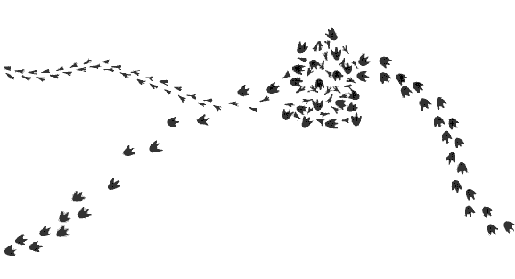
The Process of Science: Observations AND Inferences Introduction
What do you see?
List out your observations.
Be as descriptive as possible.

Slide 2
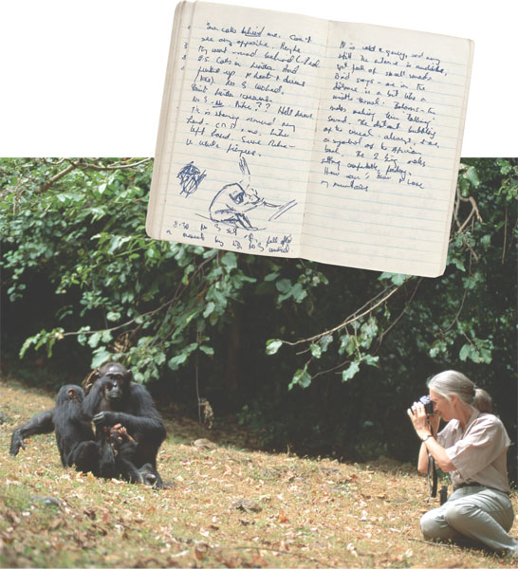
The Process of Science: Observations AND Inferences EXPLICIT INSTRUCTION (NOTES)
Observation is the process of gathering information (data).
There are two types of data
Qualitative data deals with qualities or characteristics of what is being observed.
Quantitative data deals with the quantity or measurements of what is being observed.
Inference is a logical interpretation of prior knowledge.
Inferences deal with reviewing facts that are already known.
Notes:
Q: What does the environment include?
A: The environment includes the planets land masses, oceans, atmospheres and ice caps; the animals, plants, forests and farms located on it; the places people have never visited to the places where people have developed; as well as the complex social relationships we have developed.

Slide 3
The Process of Science: Observations AND Inferences MODELING
Observations:
I see a smaller set of foot prints moving at a steady pace from left to right.
I see a larger set of foot prints moving initially at a steady pace from the bottom left toward the smaller set of foot prints.
The larger set of foot prints become more spaced out as it nears the smaller set of foot prints.

Slide 4
The Process of Science: Observations AND Inferences MODELING
Observations:
The smaller set of foot prints and larger set of foot prints merge in a cluster of non patterned foot prints.
I see the larger set of foot prints moving away from the cluster at a steady rate, but do not see any small foot prints.

Slide 5
The Process of Science: Observations AND Inferences MODELING
Inference:
A small animal was walking along when a larger predator approached.
The larger predator went after the smaller animal, in which an altercation ensued.

Slide 6
The Process of Science: Observations AND Inferences MODELING
Inference:
The larger predator was able to catch and eat the smaller animal.
The larger predator then went about it’s way.

Slide 7
The Process of Science: Observations and Inferences Guided Practice
Watch the following video about the discovery of two wooly mammoth skeletons found in a very unusual situation: NOVA: Mammoth Mystery.
Design a chart, like seen to the right, to record the observations and inferences.
What observations the scientist made (qualitative and quantitative)?
What was their explanation (inferences) about what happened to these wooly mammoths?
Observations | Inferences

Slide 8
The Process of Science: Observations and Inferences INDEPENDENT PRACTICE
What is the relationship between observations and inferences, and how do they affect the scientific process?
How can observations and inferences be used to understand the natural world?
Fill in the following table. Make three observations and an inference to pair with each observation you’ve made.
Observation | Inference

Slide 9
The Process of Science: Observations and Inferences HOME LEARNING
Performance Task: Imperiled Species Management Plan:
It will be your task to create a species action plan for a threatened or endangered species native to the state of Florida or the southeastern region of the US.
Begin researching to find what species are native to Florida or the Southeastern United States that are threatened or endangered.
Identify at least 3 species for which you would be interested in designing a Species Management Plan (minimum of one plant/animal).
Using your newly acquired skills of observation and inference, research and answer the following for the 3 species you selected:
What possible reasons are they endangered or threatened?
What are the specific threats to their present and future survival?

