Slide 1
Tragedy of the commons Introduction
North Town, founded in 1903, is found just west of the Aroyo River along the Jefferson Basin. North Town has had issues with water shortages for it’s 670,000 residents. Recently there has been a proposal to divert water from the Aroyo River to supply North Town residents with water for agriculture and drinking. South Town, population of 212,000, is found along the southern portion of the Aroyo River. South Town has enjoyed wealth utilizing the water for consumption, fishing, agriculture, transport, and textile production since 1821. The diversion of water would greatly reduce the water levels in South Town meaning shortages in water for agriculture and reduced fish populations, but enable North Town the ability to grow and meet the needs of their citizens.
Which city has a greater claim to the water? Explain your answer.

Slide 2
Tragedy of the Commons EXPLICIT INSTRUCTION (NOTES)
Population Up, Resources Down
In the last several hundred years, both human population and resource consumption have increased dramatically
Resources may be visualized as a continuum from renewable to non-renewable.
Sustainable resources are resources that have the potential to renew themselves.
What are some renewable natural resources? Non-renewable natural resources? Sustainable natural resources?
In what way is living on Earth similar to living on an island?
Notes:
Q: What are some renewable natural resources? Non-renewable natural resources? Sustainable natural resources?
A: Renewable – Sunlight, wind energy, wave energy, geothermal energy. Non-Renewable – Crude oil, natural gas, coal, copper, aluminum, and other metals. Sustainable – Fresh water, forest products (e.g. timber), agricultural crops, and soil.

Slide 3
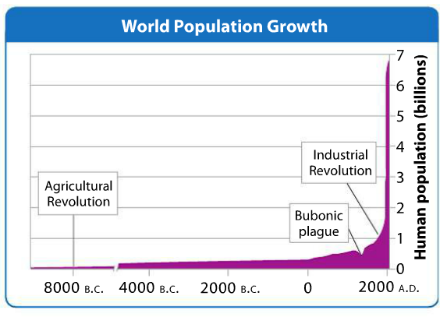
Tragedy of the Commons EXPLICIT INSTRUCTION (NOTES)
Population Up, Resources Down
Human population remained around a few million until only about 300 years ago.
The agricultural revolution enabled humans to meet better nutritional needs.
The industrial revolution improved medicine, sanitation, and food production.
What problems could come from the increase in human population?
Notes:
Q: What are some renewable natural resources? Non-renewable natural resources? Sustainable natural resources?
A: Renewable – Sunlight, wind energy, wave energy, geothermal energy. Non-Renewable – Crude oil, natural gas, coal, copper, aluminum, and other metals. Sustainable – Fresh water, forest products (e.g. timber), agricultural crops, and soil.

Slide 4
Tragedy of the commons Modeling
In 1968, environmentalists coined a term or concept called the “Tragedy of the Commons.” It stated:
Any resource that is open to everyone – such as air or parts of the ocean – will eventually be destroyed.
Everyone can use it, but no one is responsible for preserving it.
When people are not compelled to look out for future generations the Tragedy of the Commons will occur.

Slide 5
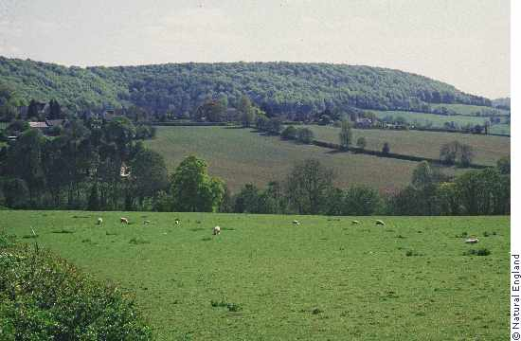
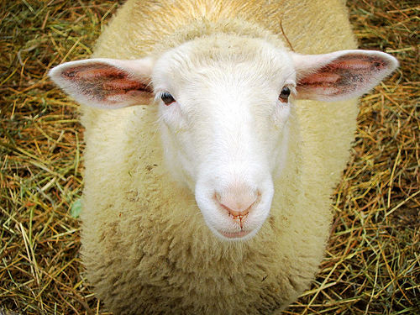
Tragedy of the commons Modeling
Once upon a time there was a lovely village, with a lovely commons where sheep grazed…
The village was happy and the sheep were happy, and happy sheep made wool…

Slide 6
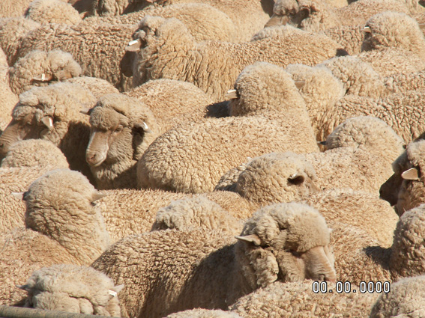
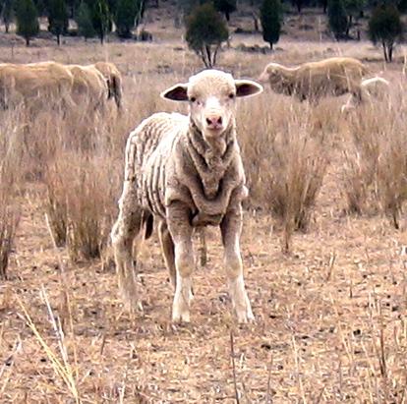
Tragedy of the commons Modeling
But as more sheep joined the commons, the commons were overused…
The grass ran out, tragedy ensued and the sheep suffered…

Slide 7
Tragedy of the commons Guided Practice
Each person represents a family that is hungry. You must catch fish for your family to survive.
Once a year you may take 0 – 4 fish from the local lake, it is your choice how many. If you take only one fish your family will starve, if you take more you profit.
At the end of each year more fish will be added to the lake through reproduction (the teacher will restock the fish).
Fish for five years and record your data on the Student Data Sheet.
Start over and replay the game for a second set of data.

Slide 8
Tragedy of the commons INDEPENDENT PRACTICE
Did anyone in your group take too many fish? How did that make you feel? Did everyone try to take as many as possible? Why or why not? Does society reward those with the “most?”
Did anyone sacrifice the # of fish, for the good of the community? Why or why not? Does society ever reward that type of person?
In Game 2, how did your strategy change, if at all? Does it make a difference to know what the rewards are?
Is it possible to maximize the number of fish caught per person AND the number of fish remaining in the pond at the same time? Why or why not?

Slide 9
Tragedy of the commons INDEPENDENT PRACTICE
Think of a local commons that you are familiar with (parking lots, pizza parties, etc). Do similar situations arise? Explain. How might those problems be solved?
What are some natural resources that are common resources?
What are the global commons? Are these being used wisely? Why or why not?
What can people do to use these resources most wisely?

Slide 10
Tragedy of the Commons HOME LEARNING
Performance Task: Imperiled Species Management Plan:
It will be your task to create a species action plan for a threatened or endangered species native to the state of Florida or the southeastern region of the US.
Begin researching to find what species are native to Florida or the Southeastern United States that are threatened or endangered.
Identify at least 3 species for which you would be interested in designing a Species Management Plan (minimum of one plant/animal).
Research and answer the following for the 3 species you selected:
What possible reasons are they endangered or threatened?
What are the specific threats to their present and future survival?

