Slide 1
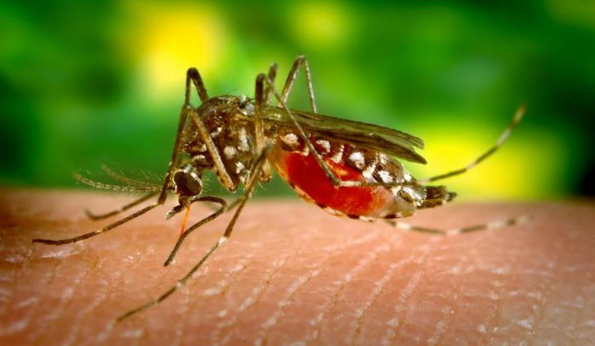
Biological and Social Hazards Introduction
What is the relationship between environmental health and our personal health?
Consider: Female Anopheles mosquitoes can transmit the malaria pathogen when they bite. DDT, a pesticide we discussed last class, kills Anopheles mosquitoes. Does this fact justify spraying DDT in Africa? Why or why not?

Slide 2
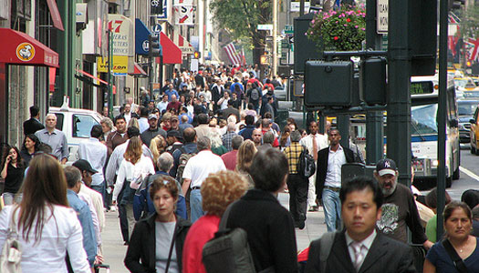
Biological and Social Hazards Explicit Instruction
Infectious diseases are spread by human contact, through food and water, and by animals.
Infectious diseases are caused by pathogens, such as a virus or bacterium.
Spread of infectious diseases is less of a threat in developed nations due to public health.
Water treatment facilities
Waste management
Health education
Improved medical facilities
Improved, available medicine

Slide 3
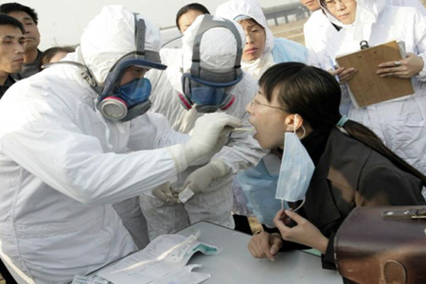
Biological and Social Hazards Explicit Instruction
New diseases are continually emerging, making epidemiology important.
Emerging diseases is a disease that has appeared in the human population for the first time (e.g. H1N1 swine flu).
Emerging diseases may lead to an epidemic because humans have developed little to no resistance to them.
An epidemic is a widespread occurrence of an infectious disease in a community over a period of time.
A pandemic may eventually occur, in which the outbreak affects a whole region, continent, or the world.

Slide 4
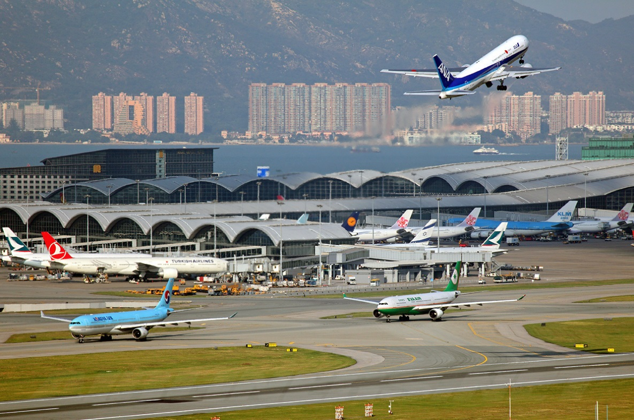
Biological and Social Hazards Explicit Instruction
Factors causing diseases to spread include:
Many diseases are becoming more mobile as society globalizes (people and animals are moved around Earth).
Some diseases are becoming resistant to our antibiotics.
Environments are changing as people encroach on land in which other animals live.
Longer warm seasons mean longer seasons for spread of tropical diseases.

Slide 5
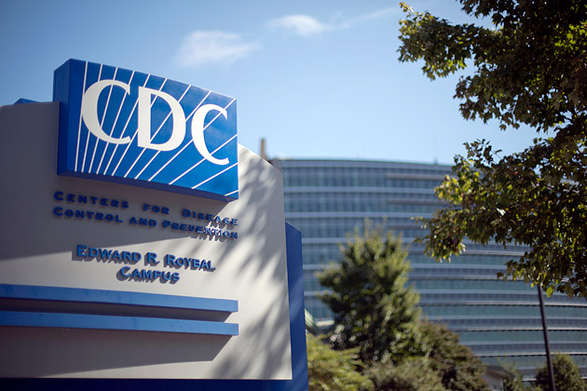
Biological and Social Hazards Explicit Instruction
Response to emerging and other infectious diseases include:
International organizations such as (WHO) World Health Organization have set up networks of agencies, labs, and medical centers world wide.
Individual nations respond to epidemics such as the United States’ (CDC) Centers for Disease Control and Prevention.

Slide 6
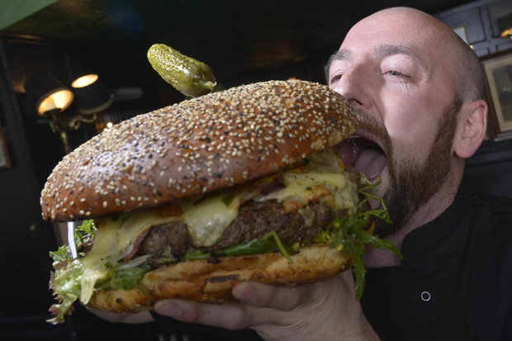
Biological and Social Hazards Explicit Instruction
Some social hazards result from lifestyle choices, while others cannot be controlled.
e.g. Smoking is a choice, while exposure to second-hand smoke may not be.
e.g. In developed countries a healthy diet is a choice, in impoverished countries a healthy diet may not be.

Slide 7
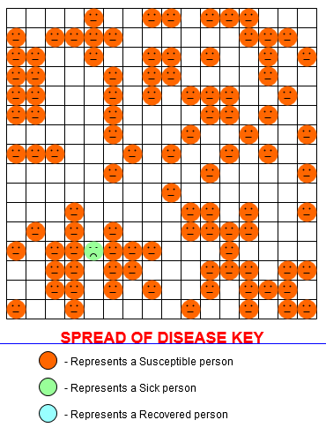
Biological and Social Hazards Guided Practice
Spread of Disease simulator: http://shodor.org/interactivate/activities/SpreadofDisease/
Terms:
Susceptible Person – A person at risk of becoming infected.
Sick Person – A person who is infected.
Recovered Person – A person who has recovered from being sick and is now immune.
Sick Rate – the probability the person will becomes sick when in contact with a sick person.
Recovery Rate – the probability that a person will recover from a disease.
Susceptibility Rate – the probability that a person will becomes susceptible again.

Slide 8
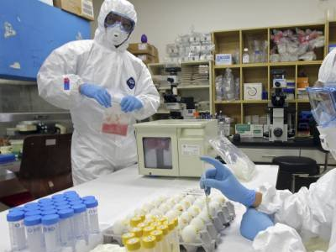
Biological and Social Hazards Independent Practice
What is the relationship between environmental health and our own health?
Describe three ways a pathogen can spread through the environment.
Why is it important to have an international organization such as the World Health Organization coordinating responses to diseases?
Do you think modern medicine will ever eliminate biological hazards from the Earth? Why or why not?

