Slide 1
Toxic Substances Introduction
List at least five places or items at your home that expose you to harmful chemicals.
For each of the places or items listed, what chemical are you exposed to and what are the possible health risks?

Slide 2
Toxic Substances Explicit Instruction
All chemicals can be hazardous in large enough quantities.
Pollution is matter or energy that causes negative effects to the environment.
Chemical hazards can cause cancer, birth defects and improper functioning of the human body.
Common groups of hazardous chemicals include carcinogens, chemical mutagens, teratogens, neurotoxins, allergens and endocrine disruptors.
Hazardous Chemical | Effect
Carcinogens | Causes cancer
Chemical mutagen | Alters DNA
Teratogens | Harm embryo or fetal development
Neurotoxins | Impair or hinders the nervous system
Allergens | Over-activate the immune system
Endocrine disruptors | Interfere in endocrine system function

Slide 3
Toxic Substances Explicit Instruction

Slide 4
Toxic Substances Explicit Instruction
Our homes and buildings contain many types of chemical hazards including asbestos, radon, (VOCs) volatile organic compounds, carbon monoxide, and lead.

Slide 5
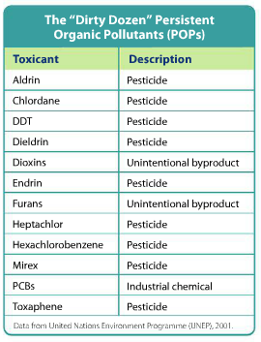
Toxic Substances Explicit Instruction
There are also chemical hazards in the outside air, in the soil, and in our water systems.
Toxic chemicals may accumulate in organisms as they feed on each other through a process called bioaccumulation.
The accumulation of these substances may become magnified up the food chain through biomagnification.

Slide 6
Toxic Substances Guided Practice
If you’ve had a drink from a reusable water bottle or eaten canned food, chances are you’ve swallowed a little (BPA) Bisphenol-A. BPA is an important chemical building block in polycarbonate plastic, which is a clear, nearly shatter-proof plastic used to make water bottles and baby bottles. BPA is also part of plastic films used to line food and soft drink cans. Over time, BPA can leach out of plastic and be consumed along with foods and drinks. Most people have some BPA in their bodies – of thousands of Americans tested, 95% had traces of BPA in their urine.
In the late 1990s, some scientists became concerned that BPA may be toxic. Many people have stopped buying bottles make of polycarbonate plastic because they are concerned about the effects of BPA on their health. But other groups, including government agencies, have claimed that the health risks of BPA are low and the public is overreacting.
“BPA mimics estrogen, which means it can cause problems with development and reproduction.”
“The majority of people only consume very small amounts of the chemical, and this is quickly metabolized and flushed out of the body before it can cause harm.”

Slide 7
Toxic Substances Independent Practice
Explain the phrase “The doses makes the poison.”
List three types of chemical hazards that affect human health and describe how each of those three affect humans.
Why might the citizens of one town need to be concerned with the chemical hazards in the air of a town many miles away?
Describe how chemical hazards can get into soil and some of the ways that they can cause harm to humans.

