Slide 1
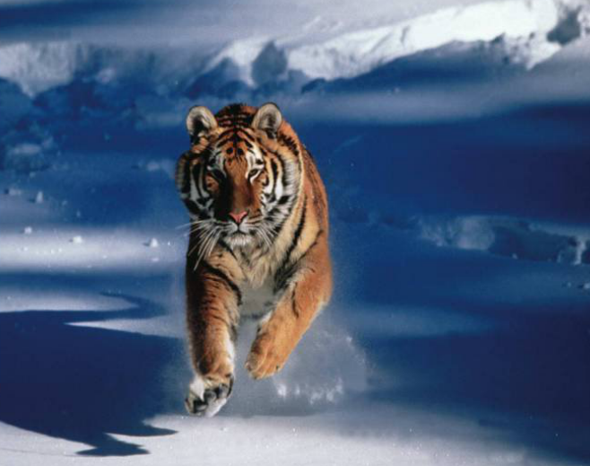
Extinction & Biodiversity Loss
Introduction
Why is it important to protect biodiversity?
What are some factors that could cause biodiversity to decrease?

Slide 2
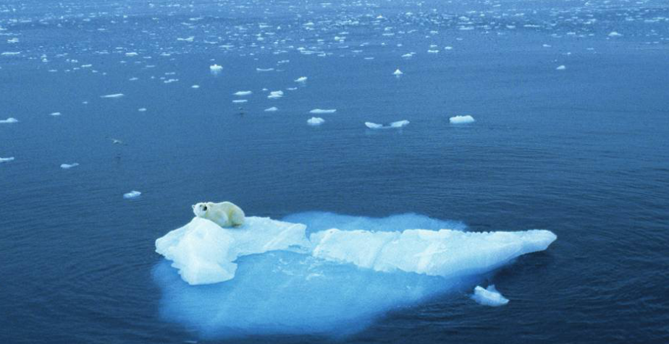
Extinction & Biodiversity Loss
Explicit Instruction
Recent decades have had a higher than normal extinction rate.
  Sometimes population groups disappear, but not the entire species globally (extirpation)
  Natural Biodiversity Loss
    The “background rate of extinction” is approximately 1 per every 1-10 million species per year prior to humans.
    There have been 5 mass extinctions in Earth’s history.
    Current rates are 100-1000 times greater than the background rate of extinction.

Slide 3
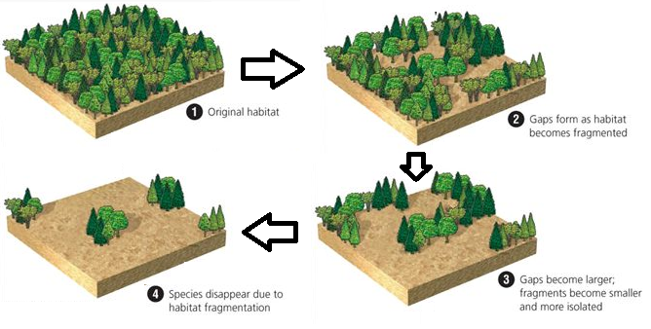
Extinction & Biodiversity Loss
Explicit Instruction
Causes for changes in biodiversity include:
  Habitat change and loss – it accounts for the greatest loss of biodiversity.
    Habitat fragmentation causes populations to be broken up into more susceptible groups.
  Invasive species – may push native species to extinction.
  Pollution – poisons the environment, making it more difficult to survive in.
  Overharvesting – reduces population.
  Climate change – extreme weather events have increased stress on populations.

Slide 4
Extinction & Biodiversity Loss
Guided Practice
Obtain supplies (cup, fork and jar of “fish”)
Predict what will happen as you try to capture “fish.”
Assign roles (timekeeper, data collector, and two alternating fishers).
Sprinkle jar contents onto desktop into a single layer. Place cup on the desktop.
Use fork to capture “fish” for 15 seconds each round.
Count the number of fish caught, by type, each round. Return all “Red bean fish” back to the desktop (water).
Repeat steps 4-6 for a total of 4 rounds.
Return contents back to jar. Return cup, fork and jar of “fish” back to the instructor.
Data Table
Trip | Red bean Fish | White bean Fish | Pea Fish | Black bean Fish
1
2
3
4
Total
Original Population | 10 | 20 | 30 | 25

Slide 5
Extinction & Biodiversity Loss
Independent Practice
What was your prediction?
Were any of your fish species extirpated? Explain.
Do you predict, based on your data, that any of the fish species will become extinct? Explain.
How did the biodiversity of the body of water compare before and after the fishing trips?
What would have happened to the red bean fish if it were not illegal to harvest them?
How do you think your results would have changed had you used forceps to model spear fishing instead of a fork to model trawling? Explain.

Slide 6
Extinction & Biodiversity Loss
Home Learning
Performance Task: Imperiled Species Management Plan:
  It will be your task to create a species action plan for a threatened or endangered species native to the State of Florida or the southeastern region of the United States.
    For the three species you have identified answer the following:
      What is the economic impact of the proposals you plan to implement? (be sure to consider all of the affected parties)
      What is the social impact of the proposals you plan to implement? (be sure to consider all of the affected parties)
      What is the ecological impact of the proposals you plan to implement? (be sure to consider all of the affected biotic and abiotic conditions)

