Slide 1
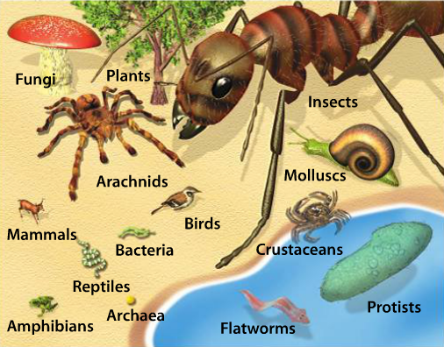
Our Planet of Life Substitute Plans
Complete Cornell Notes + on Chapter 7, Lesson 1: “Our Planet of Life.”
INDEPENDENT PRACTICE:
Complete the “Reading Checkpoint” questions as the go (p. 201, 203, & 205)
Complete “Lesson 1 Assessment” on page 206 questions 1-4.

