Slide 1
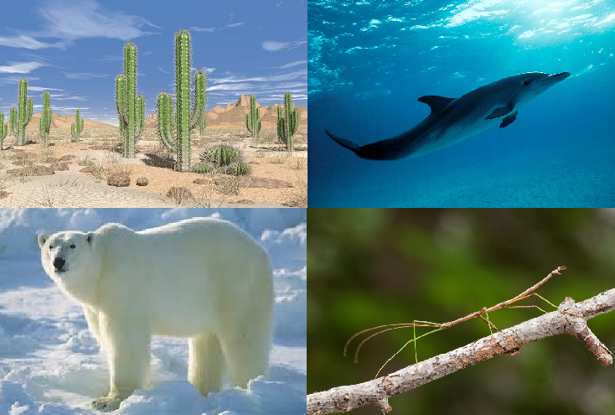
Evolution
Introduction
Describe the environment each of the four organisms lives in.
Why is it important for an organism to be well-suited for its environment?

Slide 2
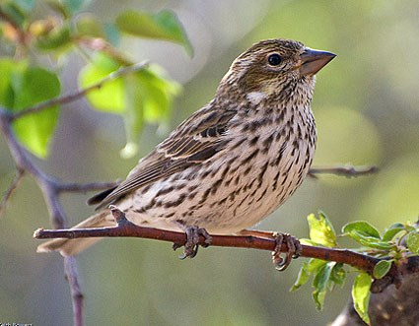
Evolution
Explicit Instruction
Evolution occurs when a population’s gene pool changes over time.
  A gene pool represents all of the genes in a given population.
  A gene is a sequence of DNA that codes for a specific trait (ex. flower color, seed shape).

Slide 3
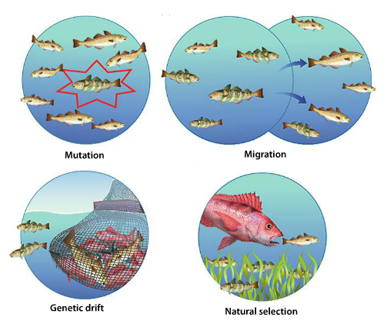
Evolution
Explicit Instruction
Mechanisms of Evolution:
  Mutations – changes in DNA that introduces genetic variation.
  Migration – a disproportionate group enters/leaves the population.
  Genetic Drift – an unusual event separates all but a few individuals of a population.
  Natural Selection – traits that improve chance for survival and reproduction are passed more frequently to offspring.

Slide 4
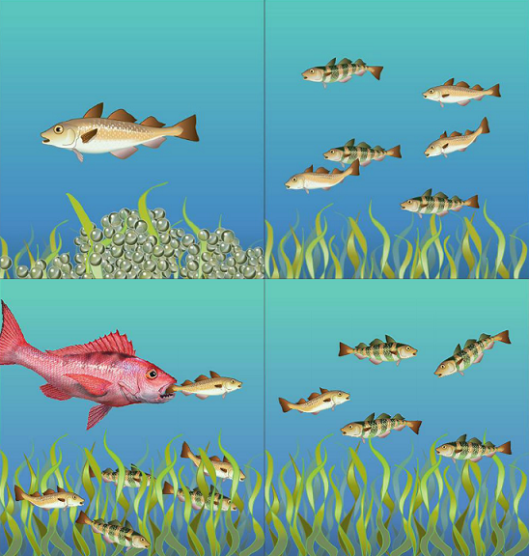
Evolution
Explicit Instruction
Conditions for Natural Selection
  More offspring than can survive.
  Individuals of a species have variation.
  Variation gives reproductive advantage.
Speciation and extinction combine to produce diversity.
  New species are generated through speciation.
  Speciation occurs when a population is broken up into smaller isolated populations.
  When a species fails to survive it is called extinction.

Slide 5
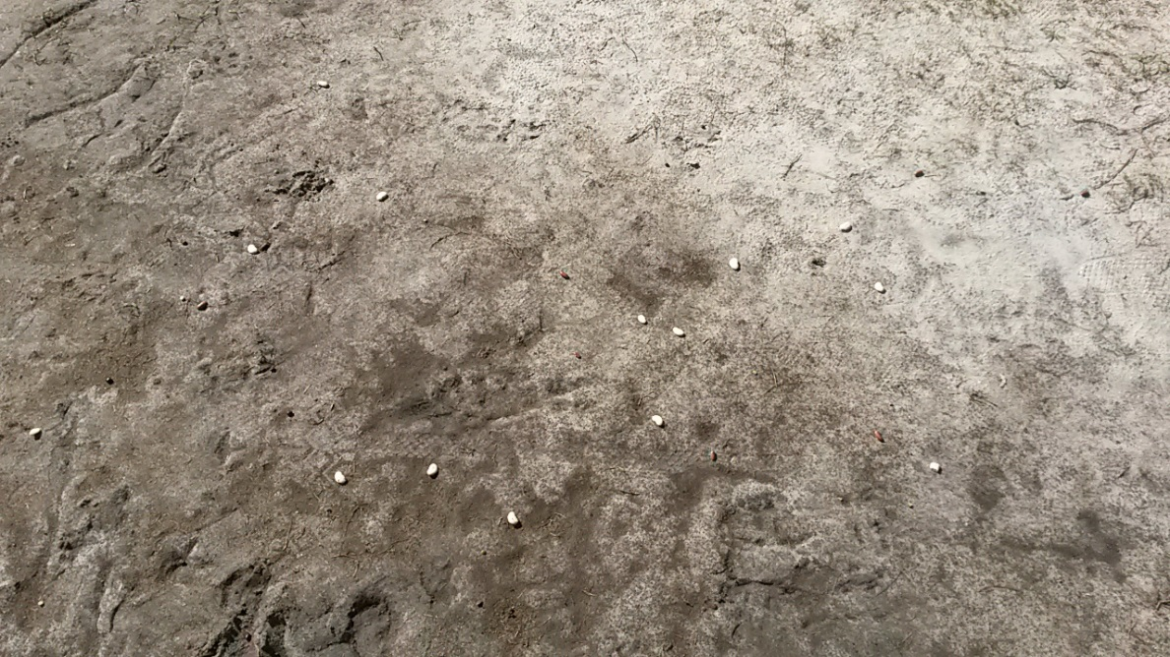
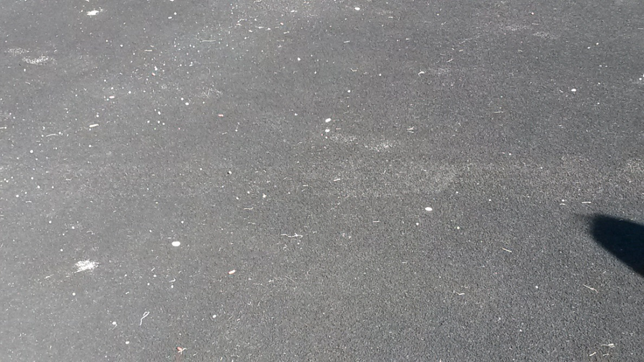
Evolution
Guided Practice
Lima beans, black beans, kidney beans and split peas are placed on a ground texture. Which of the four would be the easiest to spot on the texture?

Slide 6
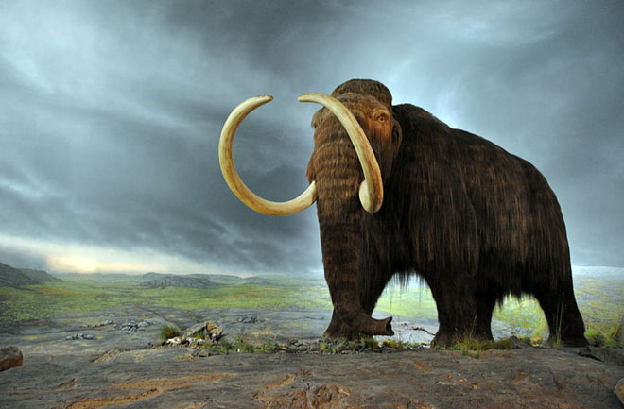
Evolution
Independent Practice
How is a gene pool and biological evolution related? What are four ways evolution may change a population’s gene pool?
Suppose conditions changed that caused seaweed to die. Now more striped fish stand out to predators than solid fish. How could natural selection result in a change in the relative number of solid and striped fish? What important concept does this illustrate about the connection between natural selection and the environment?
Why must ecologists consider both speciation and extinction when analyzing the diversity of life on Earth?

Slide 7
Evolution
Home Learning
Performance Task: Imperiled Species Management Plan:
  It will be your task to create a species action plan for a threatened or endangered species native to the State of Florida or the southeastern region of the United States.
    For the three species you have identified answer the following:
      What is the economic impact of the proposals you plan to implement? (be sure to consider all of the affected parties)
      What is the social impact of the proposals you plan to implement? (be sure to consider all of the affected parties)
      What is the ecological impact of the proposals you plan to implement? (be sure to consider all of the affected biotic and abiotic conditions)

