Slide 1
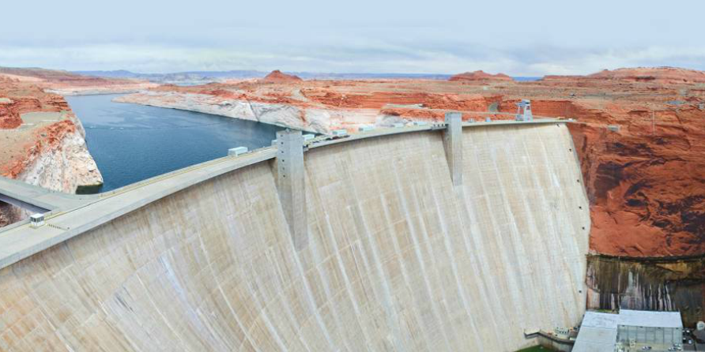
Uses of Fresh Water
Introduction
Water is a heavily used and a needed resource. What are some of the uses of water?
How do you use water around your house?
What are some uses of water in the corporate world?

Slide 2
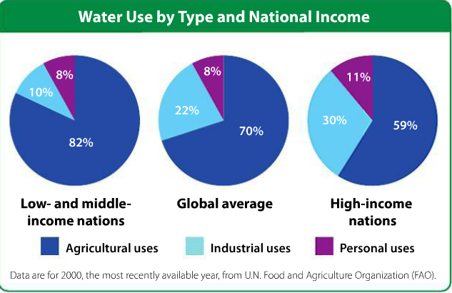
Uses of Fresh Water
Explicit Instruction
Fresh water is used for agricultural, industrial, and personal activities.
  About 70% of fresh water is used for agriculture.
  About 22% of fresh water is used for industry.
    A bottle of water requires twice as much to produce than it holds.
    Water is used to cool off machinery in power plants.
    Between 1 – 2.5 gallons of water are used to refine 1 gallon of gasoline.
  About 8% of freshwater is used for personal use.

Slide 3
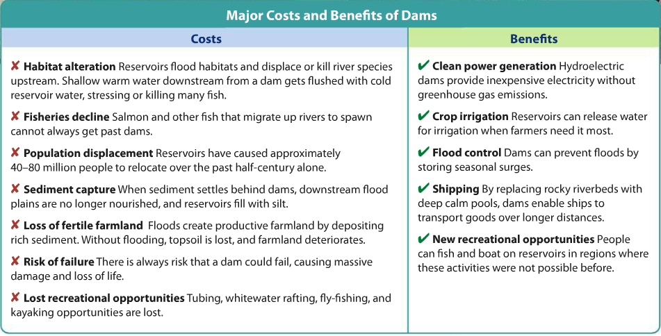
Uses of Fresh Water
Explicit Instruction
Overuse of water is depleting available resources.
  Water diversion is the process of moving water from its source to places for human use.
  Dams create artificial reservoirs to store water for human use.
Groundwater is being used faster than it can be replenished.
  Most groundwater is used for irrigation, which is very inefficient.
  Waterlogging happens when soil over-saturates so that oxygen doesn’t get in.
  Salinization occurs when salts buildup in the soil, which may make the ground unusable.

Slide 4
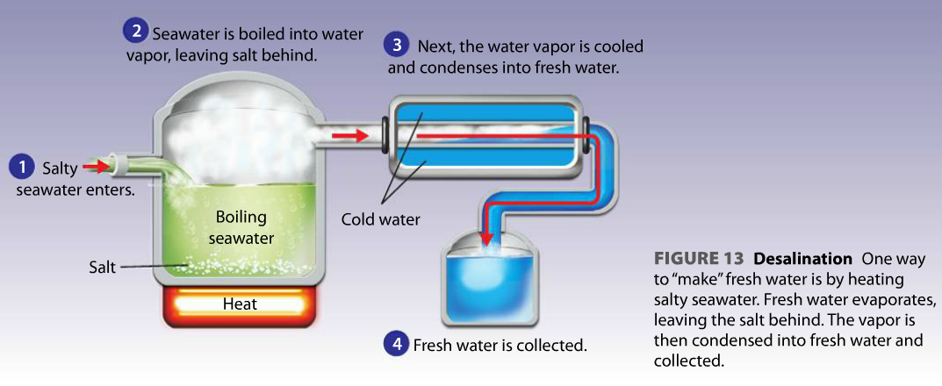
Uses of Fresh Water
Explicit Instruction
Decreasing demand for water will help with water depletion.
  Desalination, helps evaporate freshwater from salt water.
  Farmers are working to find better irrigation methods to conserve water.
  Many companies work to recycle their own water.
  Many water companies encourage residents to irrigate at night or use outdoor plants adapted for arid conditions.

Slide 5
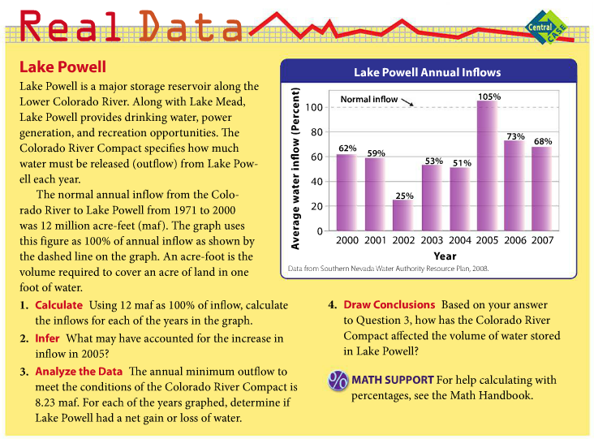
Uses of Fresh Water
Guided Practice

Slide 6
Uses of Fresh Water
Independent Practice
What are the three main categories of water use? Give an example of each.
Explain how water diversions and dams affect surface water depletion.
How does agriculture contribute to groundwater depletion? What are some possible solutions to this problem?
What solution do you think would be the most helpful in moving toward global sustainable water use? Explain your answer.

Slide 7
Uses of Fresh Water
Home Learning
Performance Task: Imperiled Species Management Plan:
  It will be your task to create a species action plan for a threatened or endangered species native to the State of Florida or the southeastern region of the United States.
    For the three species you have identified answer the following:
      What is the economic impact of the proposals you plan to implement? (be sure to consider all of the affected parties)
      What is the social impact of the proposals you plan to implement? (be sure to consider all of the affected parties)
      What is the ecological impact of the proposals you plan to implement? (be sure to consider all of the affected biotic and abiotic conditions)

