Slide 1
What is Environmental Science? Introduction
Think about the question above.
What does this question mean?
What is this question asking you?
What do you know about the environment?
What is science?
By answering these questions in you head now attempt to answer the question above on a sheet of paper.

Slide 2
What is Environmental Science? Notes
Environmental Science is the study of how the natural world works, and how humans and the environment affect each other.
The environment includes all the living things and non-living things with which organisms interact.
Humans are part of nature and rely on nature to provide food, shelter, water and the air we breathe.
Humans also provide harm to the environment by destroying habitats and by polluting water and the atmosphere.
What does our environment include?
Notes:
Q: What does the environment include?
A: The environment includes the planets land masses, oceans, atmospheres and ice caps; the animals, plants, forests and farms located on it; the places people have never visited to the places where people have developed; as well as the complex social relationships we have developed.

Slide 3
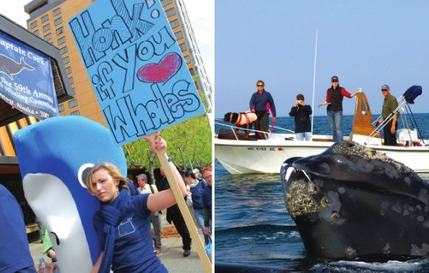
What is Environmental Science? Notes
Environmental Science v. Environmentalism
Environmental science studies the interactions within the environment and works to develop solutions to environmental problems.
Environmental science is an interdisciplinary field that borrows techniques from many different science disciplines including ecology, earth science, chemistry, biology, economics, political science, etc.
Environmentalism is the social movement, driven by personal viewpoint, dedicated to protecting the natural world.
What is the difference between environmental science and environmentalism?

Slide 4
What is Environmental Science? Questions
Guided Practice
List three examples of non-living things in the environment.
Give two reasons why environmental science is important.
Name four of the disciplines that contribute to the study of our interactions with the environment.
Independent Practice
Ecology is the study of how organisms interact with their environments. How is environmental science different from ecology? In what way is ecology part of environmental science?
Why is it important to remember that people are part of the environment too?

Slide 5
What is Environmental Science? Home Learning
Performance Task: Imperiled Species Management Plan
It will be your task to create a species action plan for a threatened or endangered species native to the state of Florida or the southeastern region of the US.
Begin researching to find what species are native to Florida or the Southeastern United States that are threatened or endangered.
Identify at least 3 species for which you would be interested in designing a Species Management Plan (minimum of one plant/animal).

