Slide 1
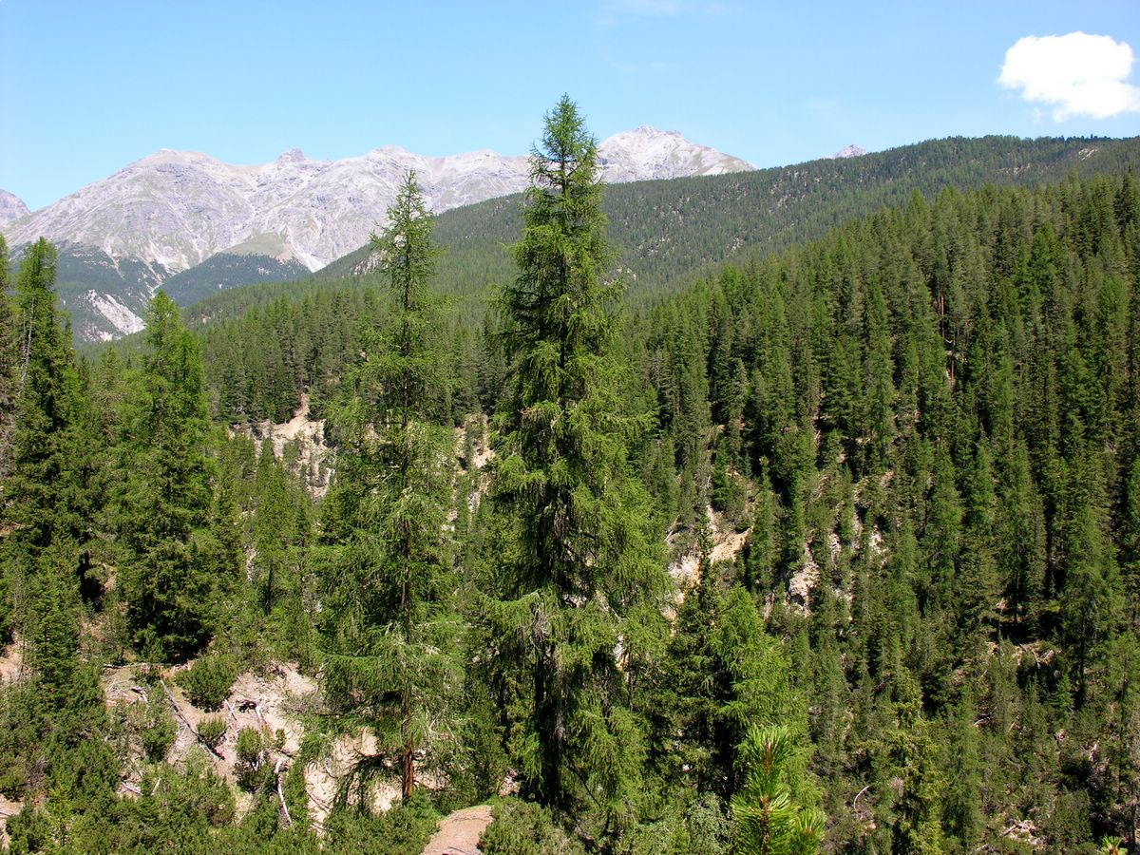
Forests and Their Resources
Introduction
Name a few types of natural resources provided by our planet.
What are the uses for the natural resources you have named?

Slide 2
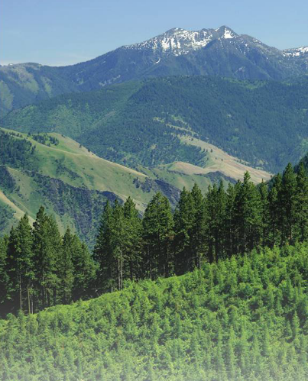
Forests and Their Resources
Explicit Instruction
Forest resources have great ecological and economic value.
  Forests cover about 30% of Earth’s surface.
  Provide habitats and food for animals.
  Prevents soil erosion, regulates the water cycle, reduces flooding, and purifies water.
  Stores carbon while releasing oxygen into the air.
  Provides timber, medicine and food for humans.

Slide 3
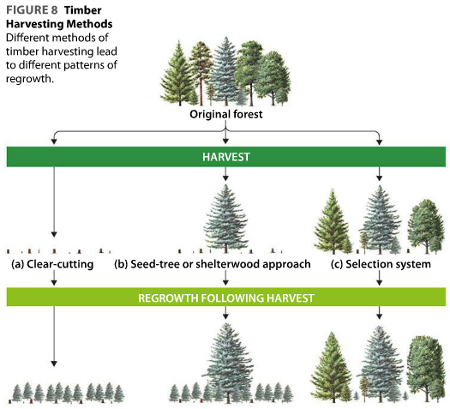
Forests and Their Resources
Explicit Instruction
Timber harvesting provides great benefit, but at a cost to the environment.
  Even-aged stands result when most of the trees in an area are cut at the same time.
    Clear-cutting is cost effective, but displaces communities.
    Seed-tree approach leaves some mature seed-bearing trees to regrow.
    Shelterwood approach leaves some mature trees to provide shelter for seedlings as they grow.
  Uneven-aged stands provides a more diversity, as different aged trees provide varying habitats.
Deforestation help nations develop, but are ecologically destructive.

Slide 4
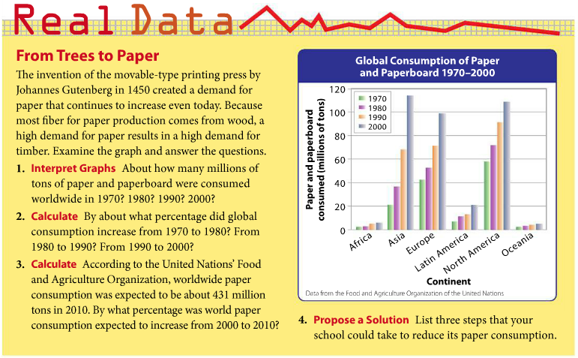
Forests and Their Resources
Guided Practice

Slide 5
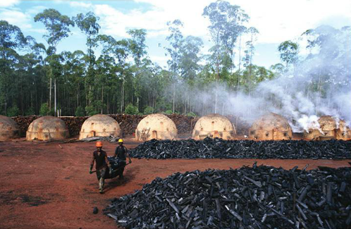
Forests and Their Resources
Independent Practice
1. What are some ways that a forest is ecologically valuable? What are some ways that a forest is economically valuable? (You may design a table)
2. What questions might an executive of a timber company consider when determining which method of harvesting to use?
3. People in developed nations often warn people in developing nations to stop destroying rain forests. People of developing nations often respond that this is hypocritical, because many of the developed nations became wealthy by deforesting their land and exploiting its resources. What would you say to the leader of a developing nation that is seeking to clear much of its forest to convince them otherwise?

Slide 6
Forests and Their Resources
Home Learning
Performance Task: Imperiled Species Management Plan:
  It will be your task to create a species action plan for a threatened or endangered species native to the State of Florida or the southeastern region of the United States.
    For the three species you have identified answer the following:
      What is the economic impact of the proposals you plan to implement? (be sure to consider all of the affected parties)
      What is the social impact of the proposals you plan to implement? (be sure to consider all of the affected parties)
      What is the ecological impact of the proposals you plan to implement? (be sure to consider all of the affected biotic and abiotic conditions)

