Slide 1
People and Their Environments Introduction
What are ways that the population of our city has impacted the local environment?
Do people living in other societies in other parts of the world impact the environment the same way we do?

Slide 2
People and Their Environments Explicit Instruction
Humans have an enormous impact on their environment.
Technology may a positive or negative on the environment.
Affluent societies | Poor societies
Consume more food Purchase more items Produce more waste Live in larger homes Use more energy | Lack infrastructure Overuse available resources Destroy habitats to meet needs
Positives | Negatives
[+] Technology may reduce environmental impact (ex. recycling, water treatment) [+] Cheaper, cleaner renewable energy (ex. Solar, wind and geothermal energy) | [-] Exploitation of resources (ex. minerals, fossil fuels) [-] Increase pollution [-] Loss of biodiversity [-] Global climate change
Activity 2: Develop - Apo Island
http://education.nationalgeographic.com/lesson/human-impacts-world-ocean/

Slide 3
People and Their Environments Guided Practice
What is your ecological footprint?
footprint.wwf.org.uk
Note: 1 £ = $1.50

Slide 4
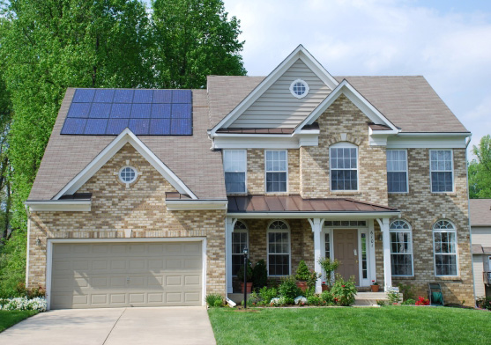
People and Their Environments Independent Practice
Explain the relationship between wealth and poverty, and impact on the environment.
How has technology had both a negative and positive impact on the environment?
As developed nations implement ways that reduce their effect on the environment, do you think this will affect quality of life throughout the world? Explain.

Slide 5
People and Their Environments Home Learning
Performance Task: Imperiled Species Management Plan:
It will be your task to create a species action plan for a threatened or endangered species native to the State of Florida or the southeastern region of the United States.
For the three species you have identified answer the following:
What is the economic impact of the proposals you plan to implement? (be sure to consider all of the affected parties)
What is the social impact of the proposals you plan to implement? (be sure to consider all of the affected parties)
What is the ecological impact of the proposals you plan to implement? (be sure to consider all of the affected biotic and abiotic conditions)

