Slide 1
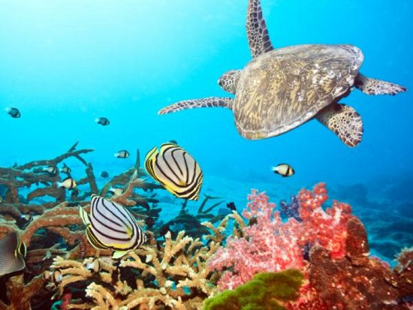
Aquatic Ecosystems Introduction
What are some types of water ecosystems that are found on Earth? Describe their characteristics.

Slide 2
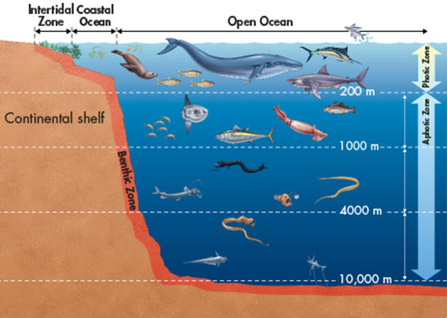
Aquatic Ecosystems Explicit Instruction
Aquatic ecosystems are classified according to salinity, depth, and water movement.
Salinity measures the amount of salt dissolved in the water (e.g. freshwater, salt water and brackish water).
Depth determines multiple factors including the amount of light available, availability of oxygen, pressure and temperature.
The photic zone is the layer in which light penetrates.
The aphotic zone is the layer in which light does not penetrate to.
The benthic zone is the layer of ground in which the water contacts (it may or may not be photic).

Slide 3
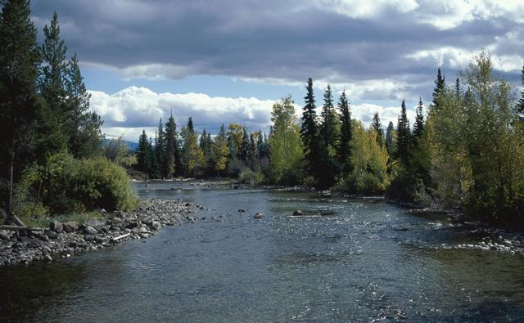
Aquatic Ecosystems Guided Practice
Types of Aquatic Ecosystems:
Ponds, lakes and Inland Seas
Freshwater Marshes
Swamps
Bogs and Fens
Rivers and Streams
Salt Marshes
Mangrove Forests
Intertidal Zones
Open-Ocean
Neritic Ecosystems
Kelp Forests
Coral Reefs

Slide 4
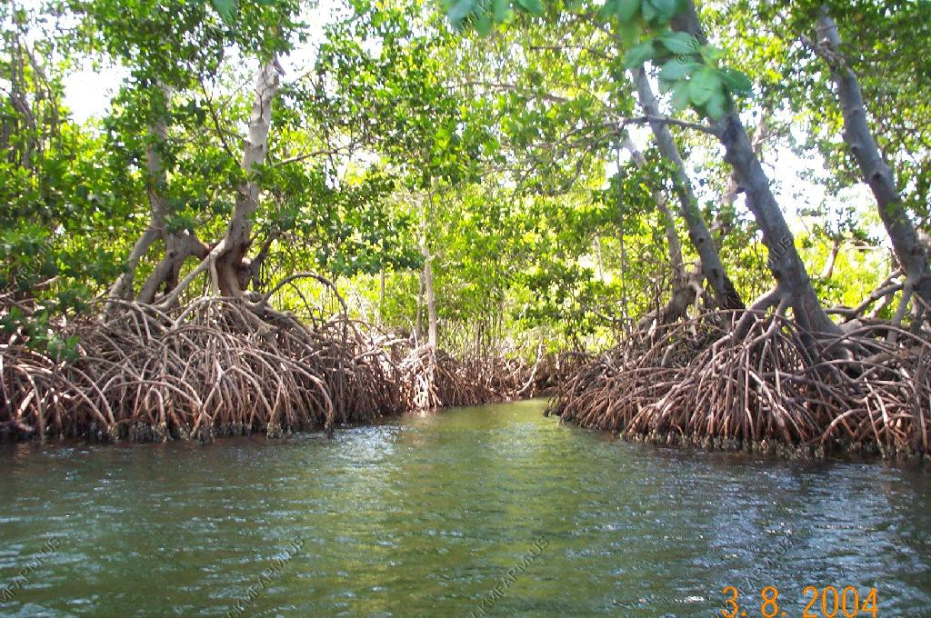
Aquatic Ecosystems Independent Practice
How do ecologist classify aquatic ecosystems? Why are organisms not the same among the aquatic ecosystems?
What are the similarities and differences among a lake, salt marsh, and kelp forest?
Why is the intertidal zone a challenging ecosystem for organisms to live there? What kinds of conditions do organisms need to be adapted for in the intertidal zone of the ocean?
How does depth affect photosynthesis in the ocean? How do organisms gain energy in aphotic zones?

Slide 5
Aquatic Ecosystems Home Learning
Performance Task: Imperiled Species Management Plan:
It will be your task to create a species action plan for a threatened or endangered species native to the State of Florida or the southeastern region of the United States.
For the three species you have identified answer the following:
What is the economic impact of the proposals you plan to implement? (be sure to consider all of the affected parties)
What is the social impact of the proposals you plan to implement? (be sure to consider all of the affected parties)
What is the ecological impact of the proposals you plan to implement? (be sure to consider all of the affected biotic and abiotic conditions)

