Slide 1
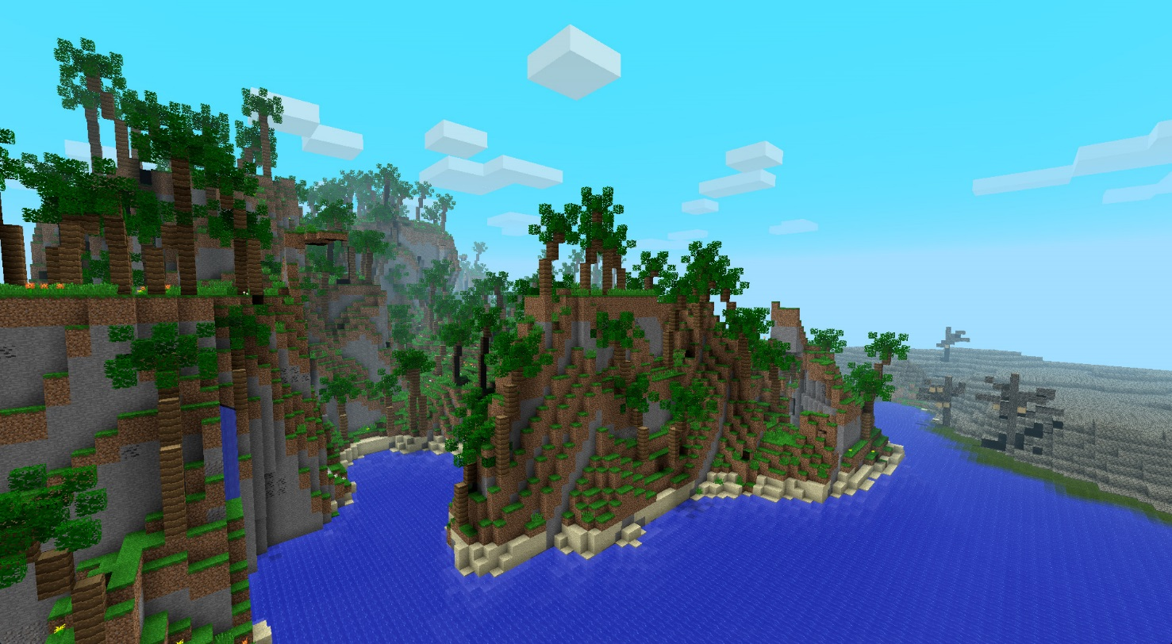
Defining Biomes
Introduction
How does the environment affect where and how an organism lives?

Slide 2
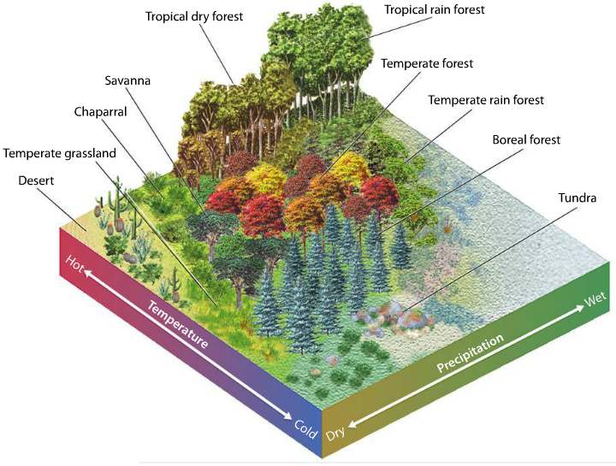
Defining Biomes
Explicit Instruction
Biomes are defined by their climates and typical plant and animal life.
  A biome is a group of ecosystems that share similar biotic and abiotic conditions.
  The biome’s climate describes the average conditions over a long period of time.
Biomes vary in their net primary production, the amount of biomass remaining after cellular respiration.
  Warmer and wet biomes have the highest net primary production.
  Cold and dry biomes have the lowest net primary production.

Slide 3
Defining Biomes
Guided Practice
Select any three of the major biomes and describe their climates. Then, give an example of a plant adaptation and an animal adaptation found in each. Explain how the adaptation benefits each organism.
Biome:
  Climate:
  Plant:
    Adaptation & Benefit:
  Animal:
    Adaptation & Benefit:
Types of biomes:
  Tropical Rain Forest
  Tropical Dry Forest
  Savanna
  Desert
  Temperate Rain Forest
  Temperate Forest
  Temperate Grassland
  Chaparral
  Boreal Forest
  Tundra

Slide 4
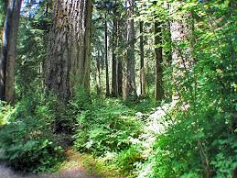
Defining Biomes
Independent Practice
What primarily determines what biome will cover a particular part of the Earth? How is natural selection important to biomes and organisms?
Which biome would you expect to have the lowest net primary productivity? Why?
Select a biome and describe it’s location, climate and some adaptations of organisms (plant and animal) found in that particular biome.

Slide 5
Defining Biomes
Home Learning
Performance Task: Imperiled Species Management Plan:
  It will be your task to create a species action plan for a threatened or endangered species native to the State of Florida or the southeastern region of the United States.
    For the three species you have identified find the following information:
      What are some strategies that you can implement to reach your conservation objective?
        What regulations could be imposed by a governmental agency (EPA, FWC, etc), including bans on hunting/killing, hunting/fishing permits, building permits, etc?
        What actions could be taken by other governmental agencies to protect or better manage factors effecting the species?
        What sort of incentives could be given to encourage those using public or private lands to comply with government regulations?
        What sort of plan could be implemented to monitor the species in the future?
        What sort of education or outreach could be implemented to improve public knowledge of the species and threats to the species?
        What future research would or could improve conditions for the species’ survival?

