Slide 1
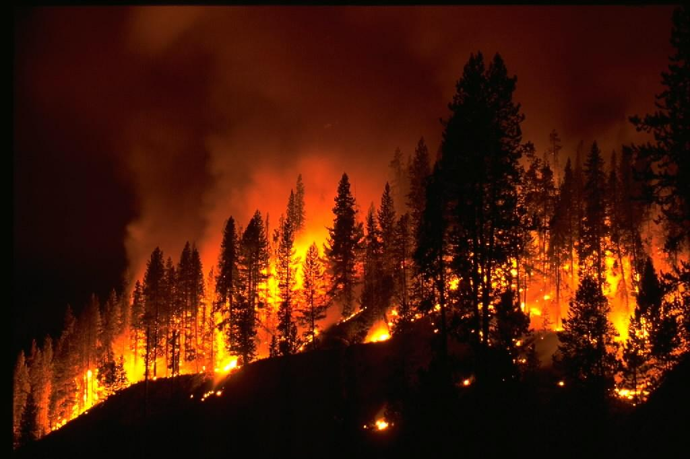
Community Stability
Introduction
Succession occurs when there is a disturbance in an ecosystem. What is a disturbance?
How might this disturbance impact the communities in the ecosystem?

Slide 2
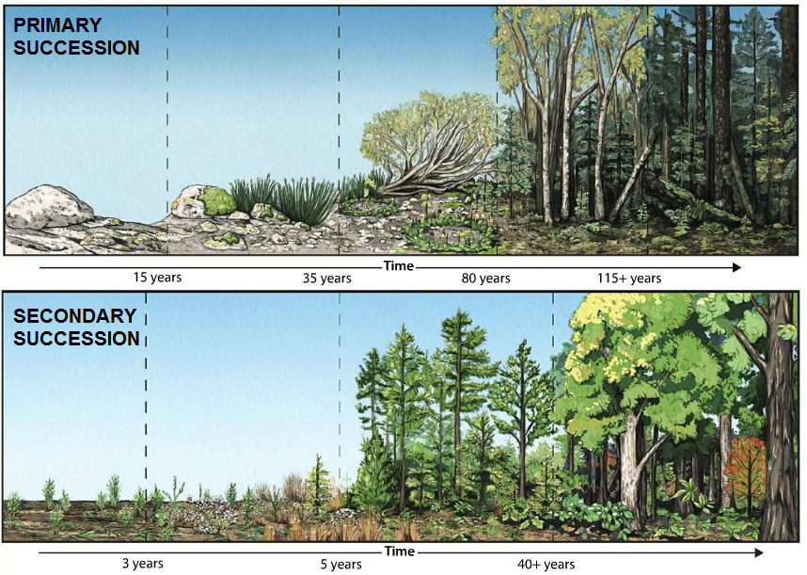
Community Stability
Explicit Instruction
Following a disturbance, communities may undergo succession.
  Succession is a predictable series of changes over time.
    Primary succession occurs when a disturbance is so severe that no vegetation or soil life remains.
      Pioneer species are the first to move in during primary succession.
    Secondary succession occurs when a disturbance isn’t enough to wipe out all organic matter.

Slide 3
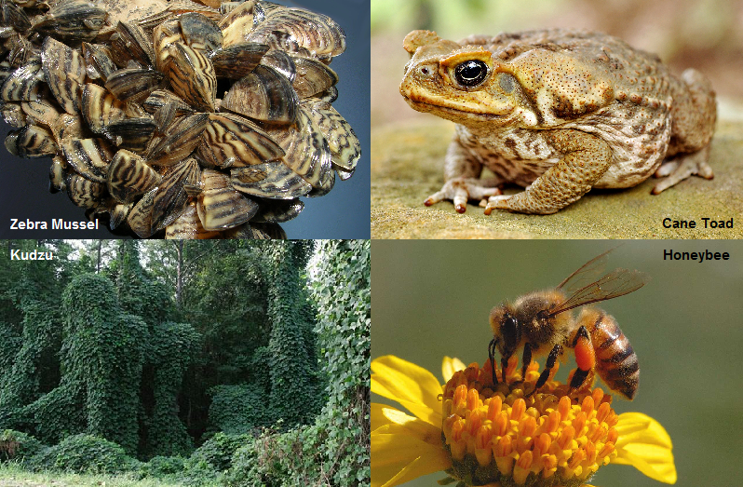
Community Stability
Explicit Instruction
Without limiting factors, introduced species may become invasive.
  An invasive species is a non-native species that can take over a community.
  Invasive species may wipe out native species and disrupt an entire community.
  A species becomes invasive when there are no natural predators, parasites or competitors in the new environment.

Slide 4
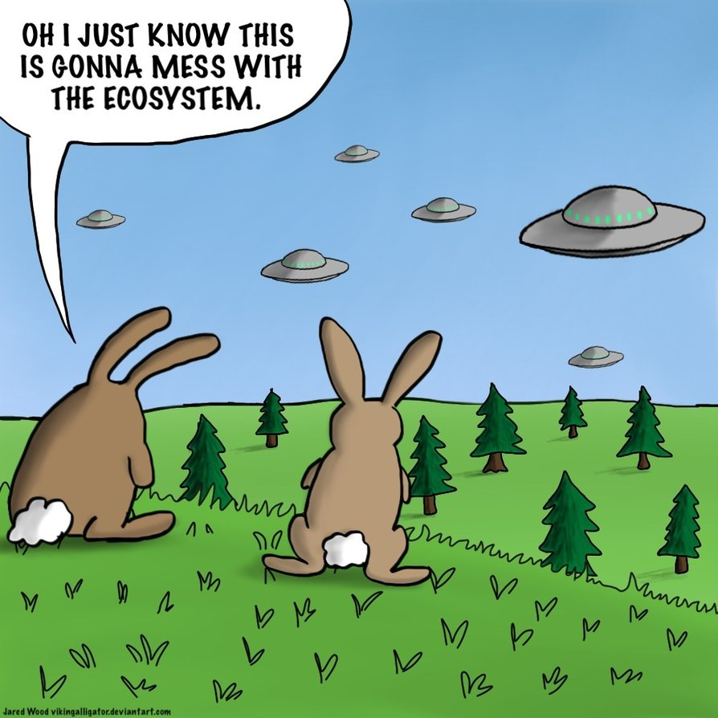
Community Stability
Guided Practice
WHAT DO YOU THINK?
Are all invasive species bad? Some have challenged the notion that all invasive species should be considered a problem. Is it always bad to change a native community? Does it make a difference whether the invasive species arrived on its own or through human intervention?

Slide 5
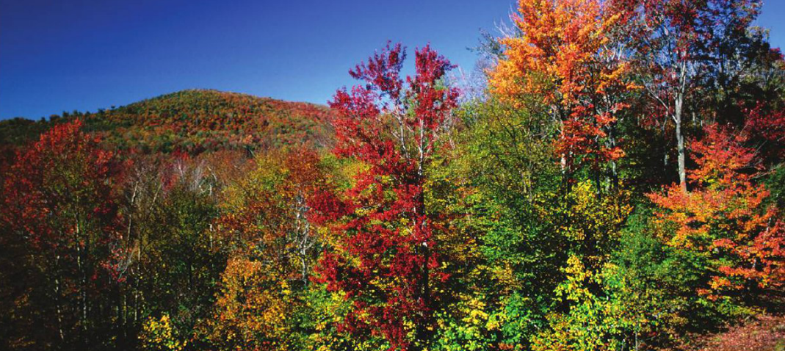
Community Stability
Independent Practice
What are the major differences between primary and secondary succession? Why is secondary succession usually faster than primary succession?
What is an invasive species? How might an invasive species disturb an ecological community?
Why is trying to prevent an invasive species more preferable than trying to control them?

Slide 6
Community Stability
Home Learning
Performance Task: Imperiled Species Management Plan:
  It will be your task to create a species action plan for a threatened or endangered species native to the State of Florida or the southeastern region of the United States.
    For the three species you have identified find the following information:
      What are some strategies that you can implement to reach your conservation objective?
        What regulations could be imposed by a governmental agency (EPA, FWC, etc), including bans on hunting/killing, hunting/fishing permits, building permits, etc?
        What actions could be taken by other governmental agencies to protect or better manage factors effecting the species?
        What sort of incentives could be given to encourage those using public or private lands to comply with government regulations?
        What sort of plan could be implemented to monitor the species in the future?
        What sort of education or outreach could be implemented to improve public knowledge of the species and threats to the species?
        What future research would or could improve conditions for the species’ survival?

