Slide 1
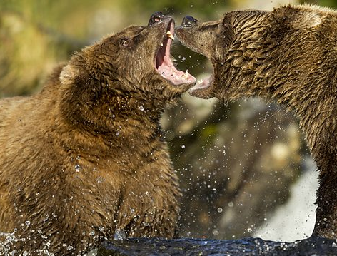
Species Interactions Introduction
Different species are constantly interacting with each other. What are some different types of relationships that these species have.
How do these interactions effect each species population? Do these relationships benefit both, benefit only one or harm both?

Slide 2
Species Interactions Explicit Instruction
An organism’s niche describes its use of resources and functional role in a community.
Species have a wide range of different interactions:
When multiple organisms seek the same resource competition ensues.
Predation, parasitism, and herbivory are interactions in which one organism benefits and the other is harmed.
Mutualism and commensalism are relationships in which neither participant is harmed.
Interaction | Description
Competition (-/-) | Two or more species seek the same limited resource
Predation (+/-) | One organism kills and consumes another.
Parasitism (+/-) | One organism depends on a host for nourishment.
Herbivory (+/-) | An animal feeds on a plant.
Mutualism (+/+) | Both organisms provide a benefit to the other.
Commensalism (+/0) | One organism provides a benefit at no cost or reward to itself.

Slide 3
Species Interactions Guided Practice
In 1997 the deer population of an island forest reserve about 518 square kilometers in size was about 2000. Although the island had excellent vegetation for feeding, the food supply had limits. The forest management personnel feared that overgrazing might lead to mass starvation. Since the area was too remote for hunters, the wildlife service decided to bring in natural predators to control the population. It was hoped that natural predation would keep the deer population from becoming too large and increase the deer health. In 1997, ten wolves were flown into the island.
Year | Wolf | Deer | Births | Eaten | Starve | Change
1997 | 10 | 2000 | 800 | 400 | 100 | +300
1998 | 12 | 2300 | 920 | 480 | 240 | +200
1999 | 16 | 2500 | 1000 | 640 | 500 | +200
2000 | 22 | 2360 | 944 | 880 | 180 | -140
2001 | 28 | 2224 | 996 | 1120 | 26 | -136
2002 | 24 | 2094 | 836 | 960 | 2 | -130
2003 | 21 | 1968 | 788 | 840 | 0 | -126
2004 | 18 | 1916 | 766 | 720 | 0 | -52
2005 | 19 | 1952 | 780 | 760 | 0 | +36
2006 | 19 | 1972 | 790 | 760 | 0 | +20
Notes:
What happened to the deer and wolf populations between 1997 and 2006?
What do you think would have happened to the deer on the island had wolves not been introduced?
Is it more natural or “right” for death by predator or starvation?

Slide 4
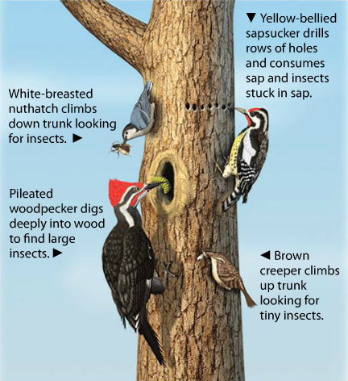
Species Interactions Independent Practice
What is resource partitioning? How is it an adaptation to competition? Give an example.
How does predation affect a population cycle? How does predation relate to parasitism and herbivory?
What is symbiosis? Describe three different types of symbiotic relationship.
How could a coevolution of two species be seen as an “evolutionary arms race?”

Slide 5
Species Interactions Home Learning
Performance Task: Imperiled Species Management Plan:
It will be your task to create a species action plan for a threatened or endangered species native to the State of Florida or the southeastern region of the United States.
For the three species you have identified find the following information:
What are some strategies that you can implement to reach your conservation objective?
What regulations could be imposed by a governmental agency (EPA, FWC, etc), including bans on hunting/killing, hunting/fishing permits, building permits, etc?
What actions could be taken by other governmental agencies to protect or better manage factors effecting the species?
What sort of incentives could be given to encourage those using public or private lands to comply with government regulations?
What sort of plan could be implemented to monitor the species in the future?
What sort of education or outreach could be implemented to improve public knowledge of the species and threats to the species?
What future research would or could improve conditions for the species’ survival?

