Slide 1
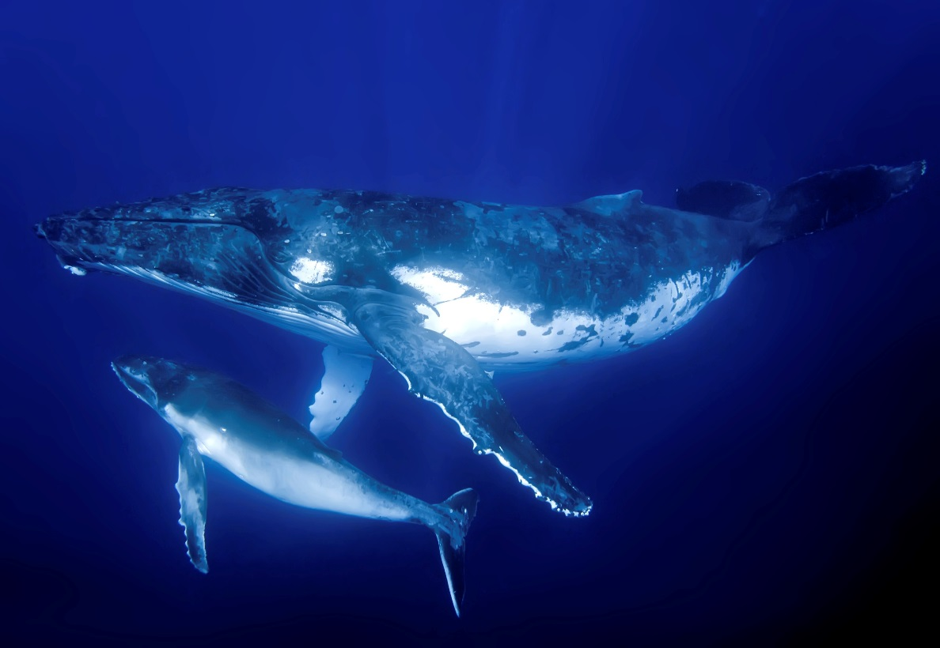
Population Growth Introduction
Name several factors that can affect a population’s growth. How does each of these factors affect the population’s growth?

Slide 2
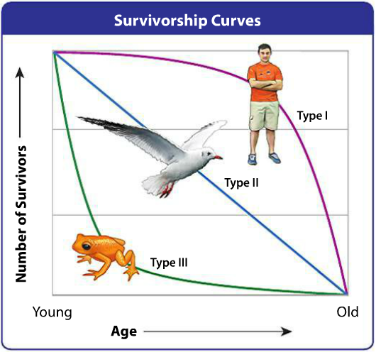
Population Growth Explicit Instruction
Birth (natality) and death (mortality) rates affect the growth rate of a population.
Survivorship curves show how likely death will occur based on age.
Age structure shows the general distribution of organisms based on age.
A species sex ratio is also important in the natality of a species.
Movement in (immigration) and out (emigration) also affects the growth rate of a population.
Sometimes organisms seasonally migrate in and out of a population. (Migration)

Slide 3
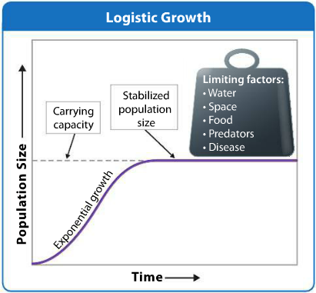
Population Growth Explicit Instruction
Population may either grow exponentially or logistically.
Exponential growth occurs when environmental conditions are ideal.
Logistical growth occurs when a population is constrained.
Limiting factors, that constrain growth, could be a limited resource, predator, etc.
The maximum population that an environment can carry is known as it’s carrying capacity.
Carry capacities may fluctuate as limiting factors change.
A population that overshoots it’s carrying capacity may crash.

Slide 4
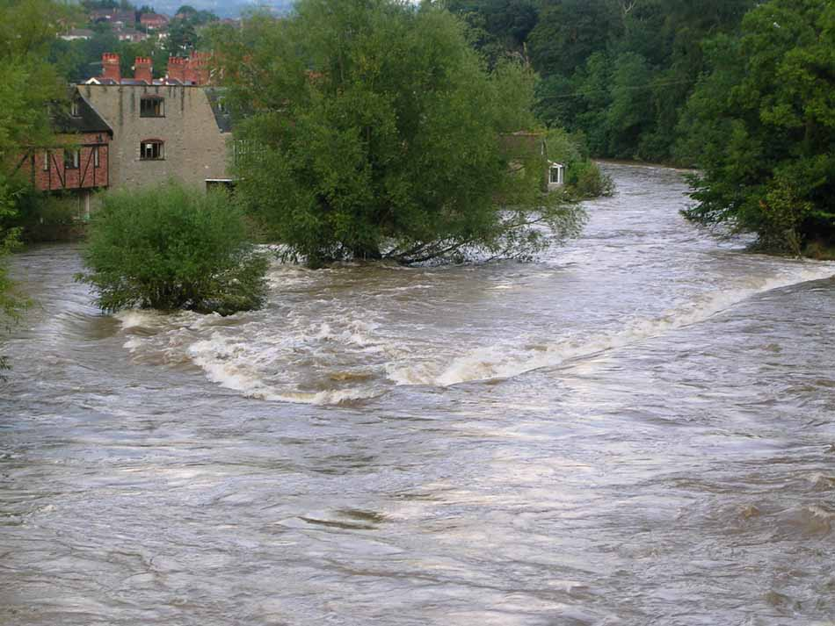
Population Growth Explicit Instruction
Population growth is kept in check by limiting factors and biotic potential.
Density-dependent factors, such as predation and disease, are affected by a population’s density.
Density-independent factors, such as fires and floods, are not affected by a population’s density.
The organism’s ability to reproduce is it’s biotic potential.
Biotic potential may be affected by gestation time, generation time, and number of offspring born at a time.

Slide 5
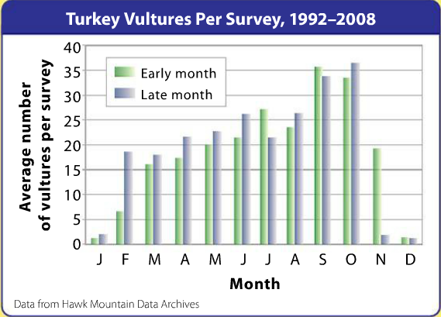
Population Growth Guided Practice
Hawk Mountain Sanctuary in Kempton, PA is a protected area for birds of prey. Scientists at the sanctuary monitor bird populations by conducting roadside surveys. Scientists drive slowly along a set route and count the birds they spot.
1. Describe the annual trend in turkey vulture sightings along the survey route.
2. What factors might be increasing the vulture population’s size? What factors decrease population size?
3. Turkey vultures arrive from north onto sanctuary lands and reside there for a while before migrating south. When do you think the vultures from the north arrive? When do you think the all leave?
4. What is one potential source of error when conducting a roadside survey?

Slide 6
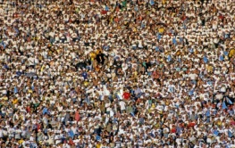
Population Growth Independent Practice
List four factors that affect the growth rate of a population and describe what affect they have on the population.
Compare and contrast exponential and logistical growth.
Explain how carrying capacity for a population can change over time.
Explain why a forest fire is considered to be a density-independent limiting factor.

Slide 7
Population Growth Home Learning
Performance Task: Imperiled Species Management Plan:
It will be your task to create a species action plan for a threatened or endangered species native to the State of Florida or the southeastern region of the United States.
For the three species you have identified find the following information:
What are some strategies that you can implement to reach your conservation objective?
What regulations could be imposed by a governmental agency (EPA, FWC, etc), including bans on hunting/killing, hunting/fishing permits, building permits, etc?
What actions could be taken by other governmental agencies to protect or better manage factors effecting the species?
What sort of incentives could be given to encourage those using public or private lands to comply with government regulations?
What sort of plan could be implemented to monitor the species in the future?
What sort of education or outreach could be implemented to improve public knowledge of the species and threats to the species?
What future research would or could improve conditions for the species’ survival?

