Slide 1
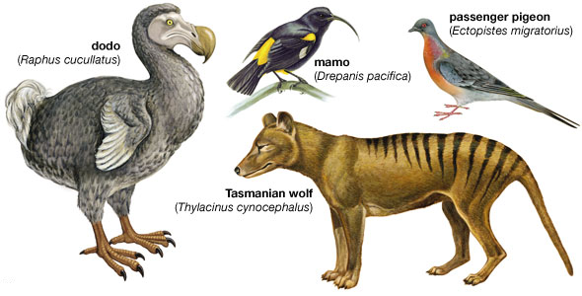
Describing Populations Introduction
Some scientists state that extinction is our greatest environmental problem.
Do you think we should be concerned about species extinction? Why or why not?

Slide 2
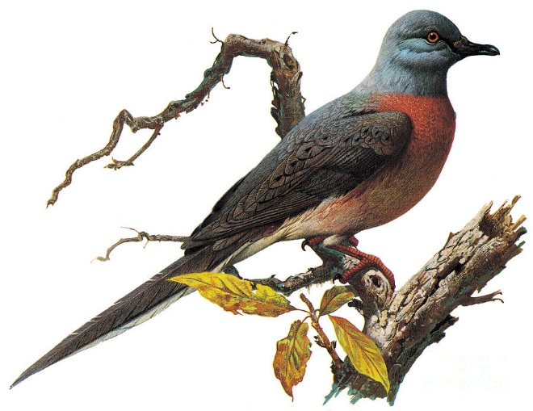
Describing Populations Explicit Instruction
All the individuals of a species together make up a population.
Tracking the number of individuals in a population (population size) can tell the relative health of the population.
Rapid changes in a population may indicate trouble for the species.
Sampling is often used to count populations that are too large to directly count.
Counting tracks or droppings is another way to count a population.

Slide 3
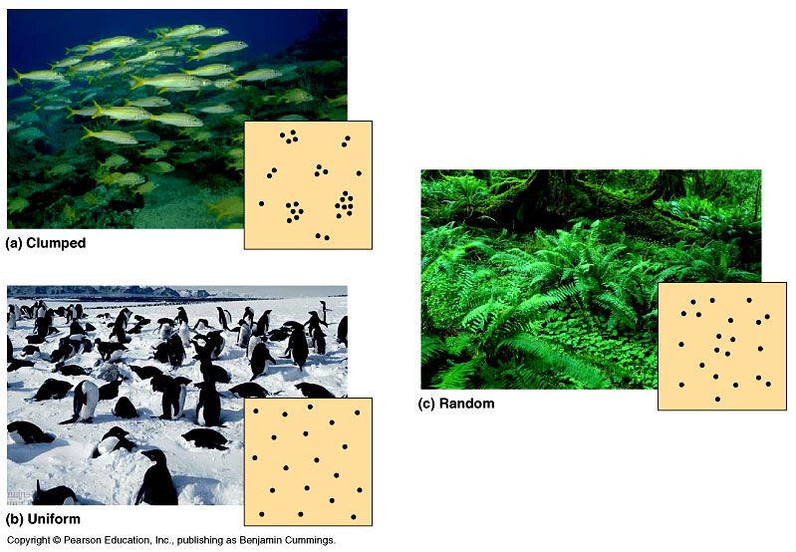
Describing Populations Explicit Instruction
Population density is a measure of how crowded a population is.
Higher density allows for ease of mating, but are more susceptible to predators and infectious diseases.
Lower density have greater space and resources, but have difficulty finding mates.
Population distribution may vary from population to population.
Random distribution
Uniform distribution
Clumped distribution

Slide 4
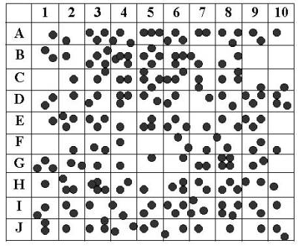
Describing Populations Guided Practice
Population Sample 1
Pick 5 boxes, either grouped or random, without looking at the distribution. Record which boxes you selected.
Count the number of dots in the five boxes you have selected and record your data.
Multiply that number by 20 (as 5 boxes only represents 5% of the total area).
What is your total estimated number of dots for the population of the entire area?
What is the actual number of dots for the population of the entire area?

Slide 5
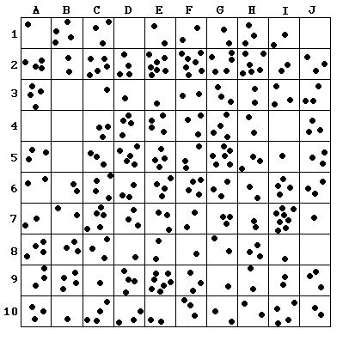
Describing Populations Independent Practice
Population Sample 2
1. Using a sampling method come up with an estimate of the entire population shown. Write down your sampling method and show all your work.
2. Confer with a fellow scientist (classmate). Record at least 3 other estimates along with a description of their sampling method and calculations.
3. What is the actual population for the entire area?
4. Why do each scientist come up with different estimates?
5. Average the four estimates. How does this average compare?

Slide 6
Describing Populations Home Learning
Performance Task: Imperiled Species Management Plan:
It will be your task to create a species action plan for a threatened or endangered species native to the State of Florida or the southeastern region of the United States.
For the three species you have identified find the following information:
What are some strategies that you can implement to reach your conservation objective?
What regulations could be imposed by a governmental agency (EPA, FWC, etc), including bans on hunting/killing, hunting/fishing permits, building permits, etc?
What actions could be taken by other governmental agencies to protect or better manage factors effecting the species?
What sort of incentives could be given to encourage those using public or private lands to comply with government regulations?
What sort of plan could be implemented to monitor the species in the future?
What sort of education or outreach could be implemented to improve public knowledge of the species and threats to the species?
What future research would or could improve conditions for the species’ survival?

