Slide 1
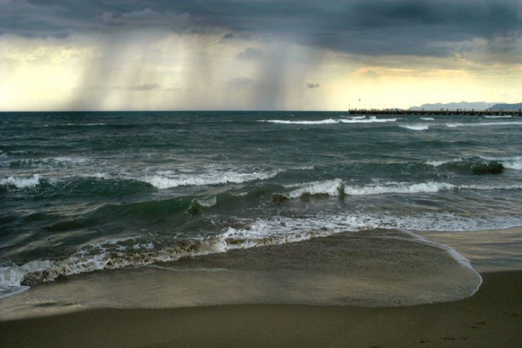
Biogeochemical Cycles
Introduction
The water cycle summarizes the many routes that water molecules take through the Earth’s spheres. Draw a diagram to illustrate the processes of the water cycle.
Try to include how the oceans, rivers, atmosphere, land plants, soil and groundwater play a role in the water cycle.

Slide 2
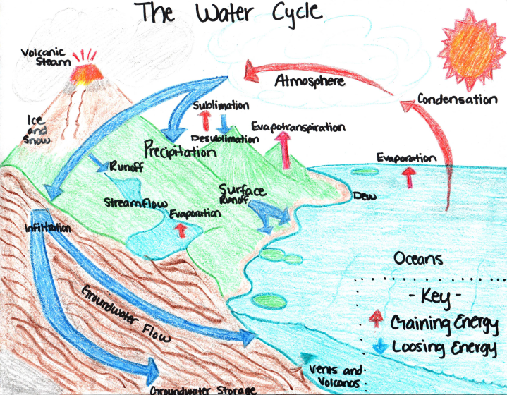
Biogeochemical Cycles
Explicit Instruction
Water cycles through the lithosphere, biosphere and atmosphere endlessly.
97.5% of the Earth’s water is salt water.
More than 3/4th of the remaining freshwater is locked up in the cryosphere (ice).
Evaporation and transpiration distill water naturally, converting water from liquid to gas.
Water returns to the Earth’s surface through condensation and precipitation.
Some water will be stored as groundwater in underground aquifers.

Slide 3
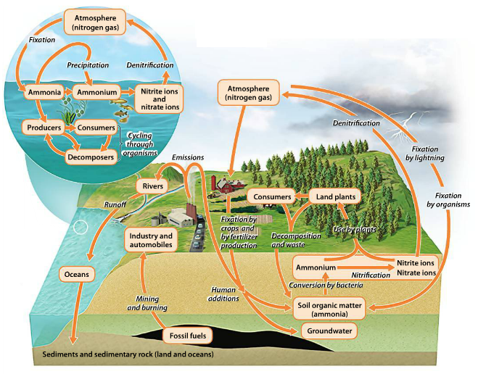
Biogeochemical Cycles
Explicit Instruction
The nitrogen cycle is very reliant on bacteria.
Bacteria have the ability to convert nitrogen gas into ammonia through nitrogen fixation.
Some bacteria may then convert ammonia into nitrate ions (used by plants) through nitrification.
Other bacteria convert nitrate ions will be converted back into nitrogen gas through denitrification.
Human activity can be problematic when excess nitrogen is introduced (eutrophication).

Slide 4
Biogeochemical Cycles
Guided Practice
Nitrogen may be found at any one of the following reservoirs: atmosphere, surface water, rainwater, groundwater, fertilizers, soils, the ocean, animal waste, dead plants and animals, live plants, or live animals.
Dependent upon what process occurs the nitrogen will continue to cycle endlessly through the nitrogen cycle.
Discussion
How many stops can you make on our trip? Will the journey ever end?
Will your journey always be the same? Why or why not?
If a farmer introduced too much fertilizer or we burnt too many fossil fuels what would happen?
Farming creates a large amount of animal waste. How would this affect the nitrogen cycle?

Slide 5
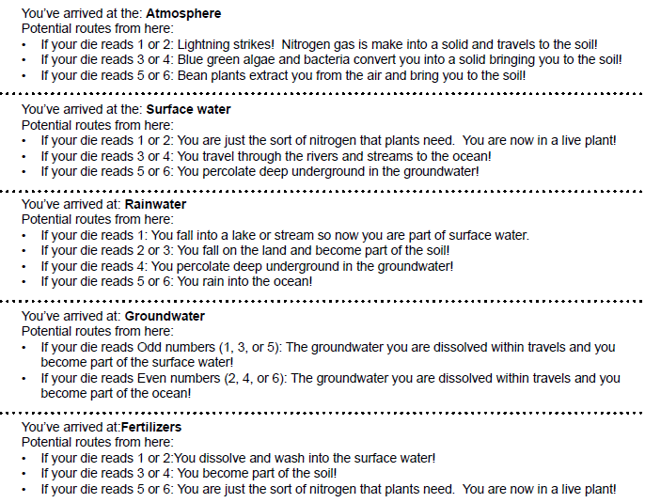
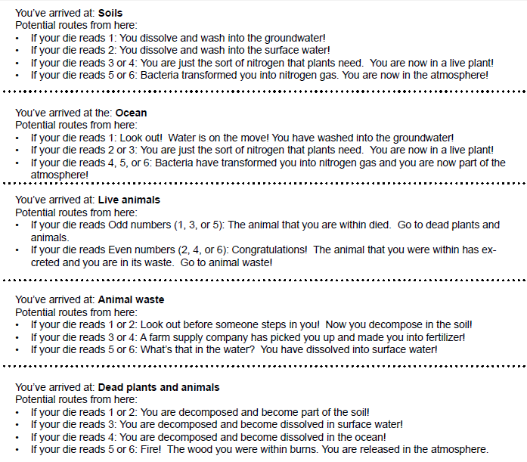

Biogeochemical Cycles
Guided Practice

Slide 6
Biogeochemical Cycles
Independent Practice
Describe the law of conservation of matter. What does this mean in regards to the biogeochemical cycles?
Describe the processes of nitrogen fixation, nitrification and denitrification. Include in your description the methods in which each process may be completed.
What is eutrophication? Why is it dangerous? What are two possible causes?

Slide 7
Biogeochemical Cycles
Home Learning
Performance Task: Imperiled Species Management Plan:
  It will be your task to create a species action plan for a threatened or endangered species native to the State of Florida or the southeastern region of the United States.
    For the three species you have identified find the following information:
      What are some strategies that you can implement to reach your conservation objective?
        What regulations could be imposed by a governmental agency (EPA, FWC, etc), including bans on hunting/killing, hunting/fishing permits, building permits, etc?
        What actions could be taken by other governmental agencies to protect or better manage factors effecting the species?
        What sort of incentives could be given to encourage those using public or private lands to comply with government regulations?
        What sort of plan could be implemented to monitor the species in the future?
        What sort of education or outreach could be implemented to improve public knowledge of the species and threats to the species?
        What future research would or could improve conditions for the species’ survival?

